Slide 1
Working Together for Better Services Scrutiny in Aberdeen City Council
By Fay Morrison Tenant & Carol Hannaford Officer Aberdeen City Council

Slide 2

So Today
Where it all started
How we did it
Structure
Our Reviews
The Reports
The Launches
When things go wrong!
Getting back on track 😊 😊 😊

Slide 3

Where it all started
West Lothian here we come
Started in 2004
Changed in 2008
2010 Owners were allowed
Provided training
Study Visits

Slide 4


The Structure
Housing Service Review Group
Housing Performance & Budget Group

Slide 5
Our Reviews
Housing Repairs
Community Safety
Housing Management
Re Review of Repairs
Feedback – Complaints and Compliments
When it all went wrong! Asset Management

Slide 6
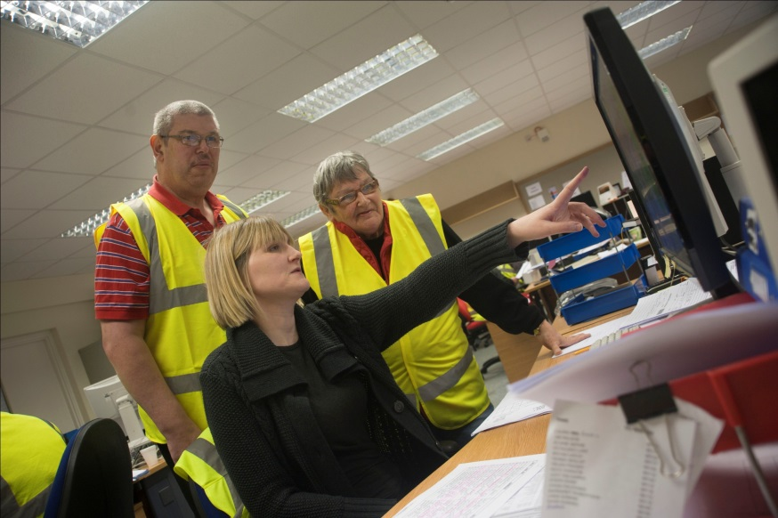



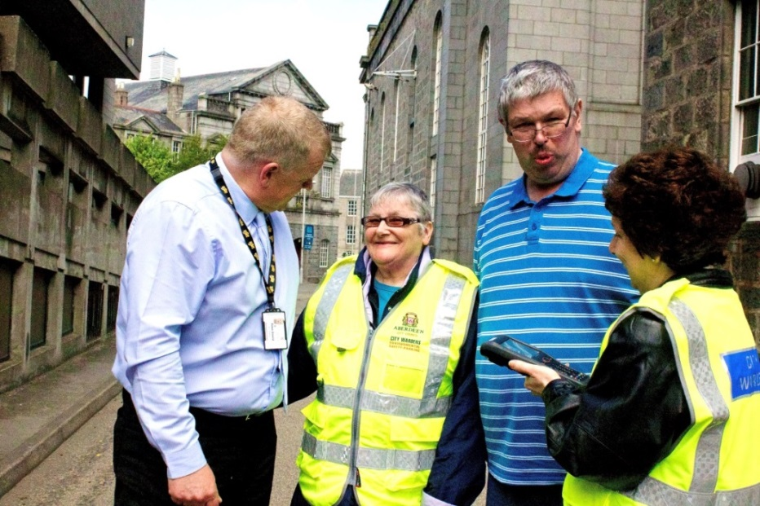

Slide 7

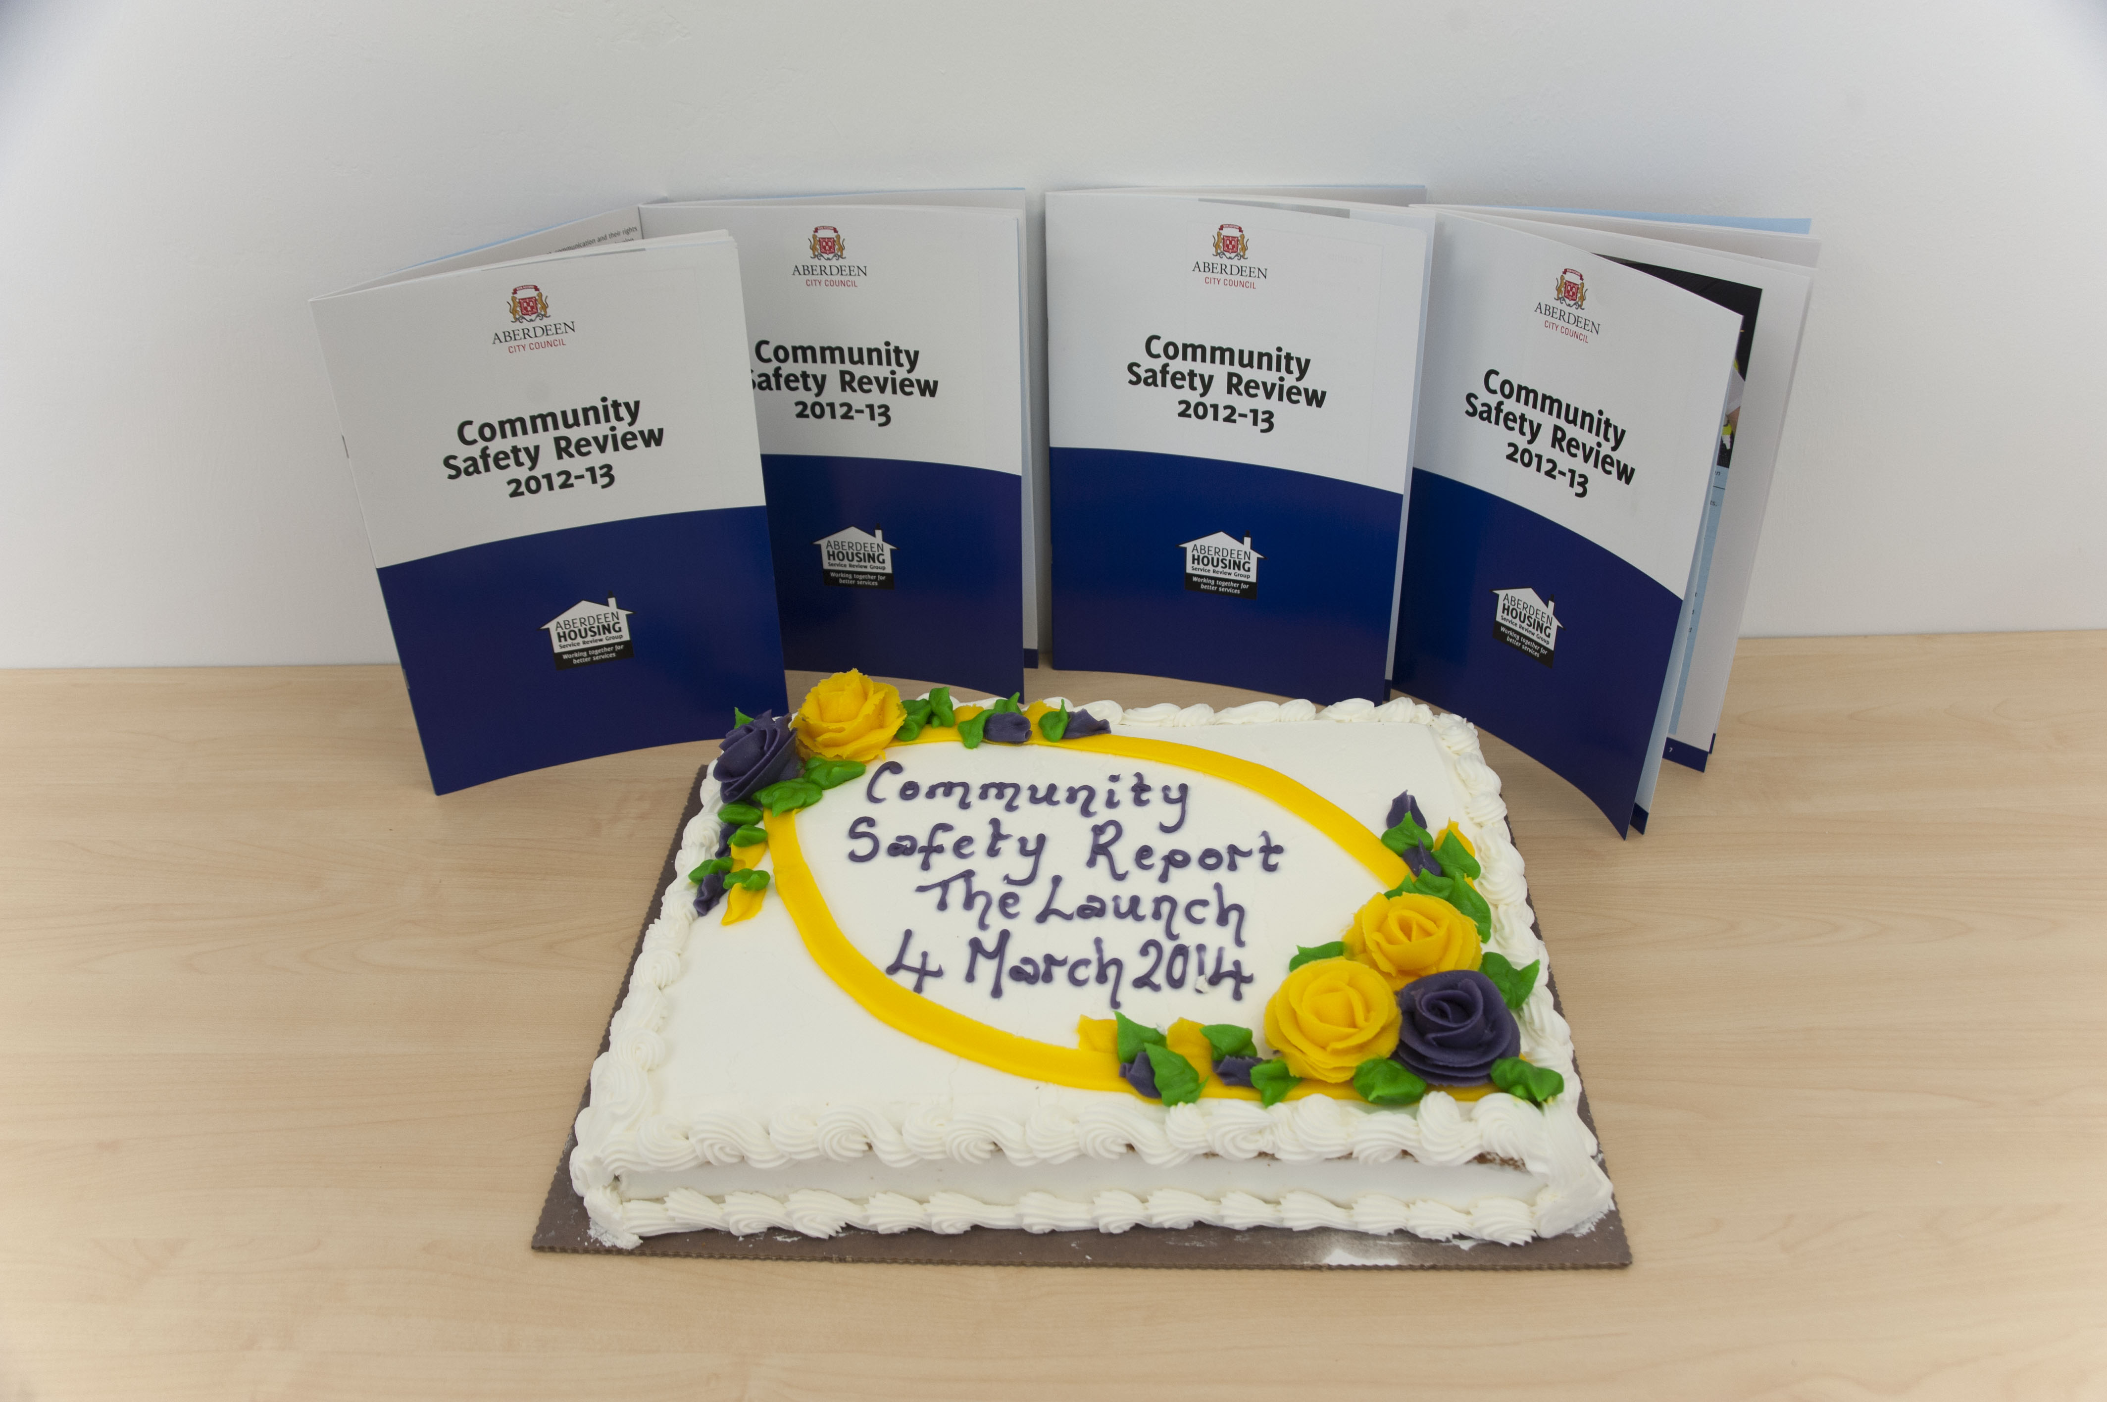
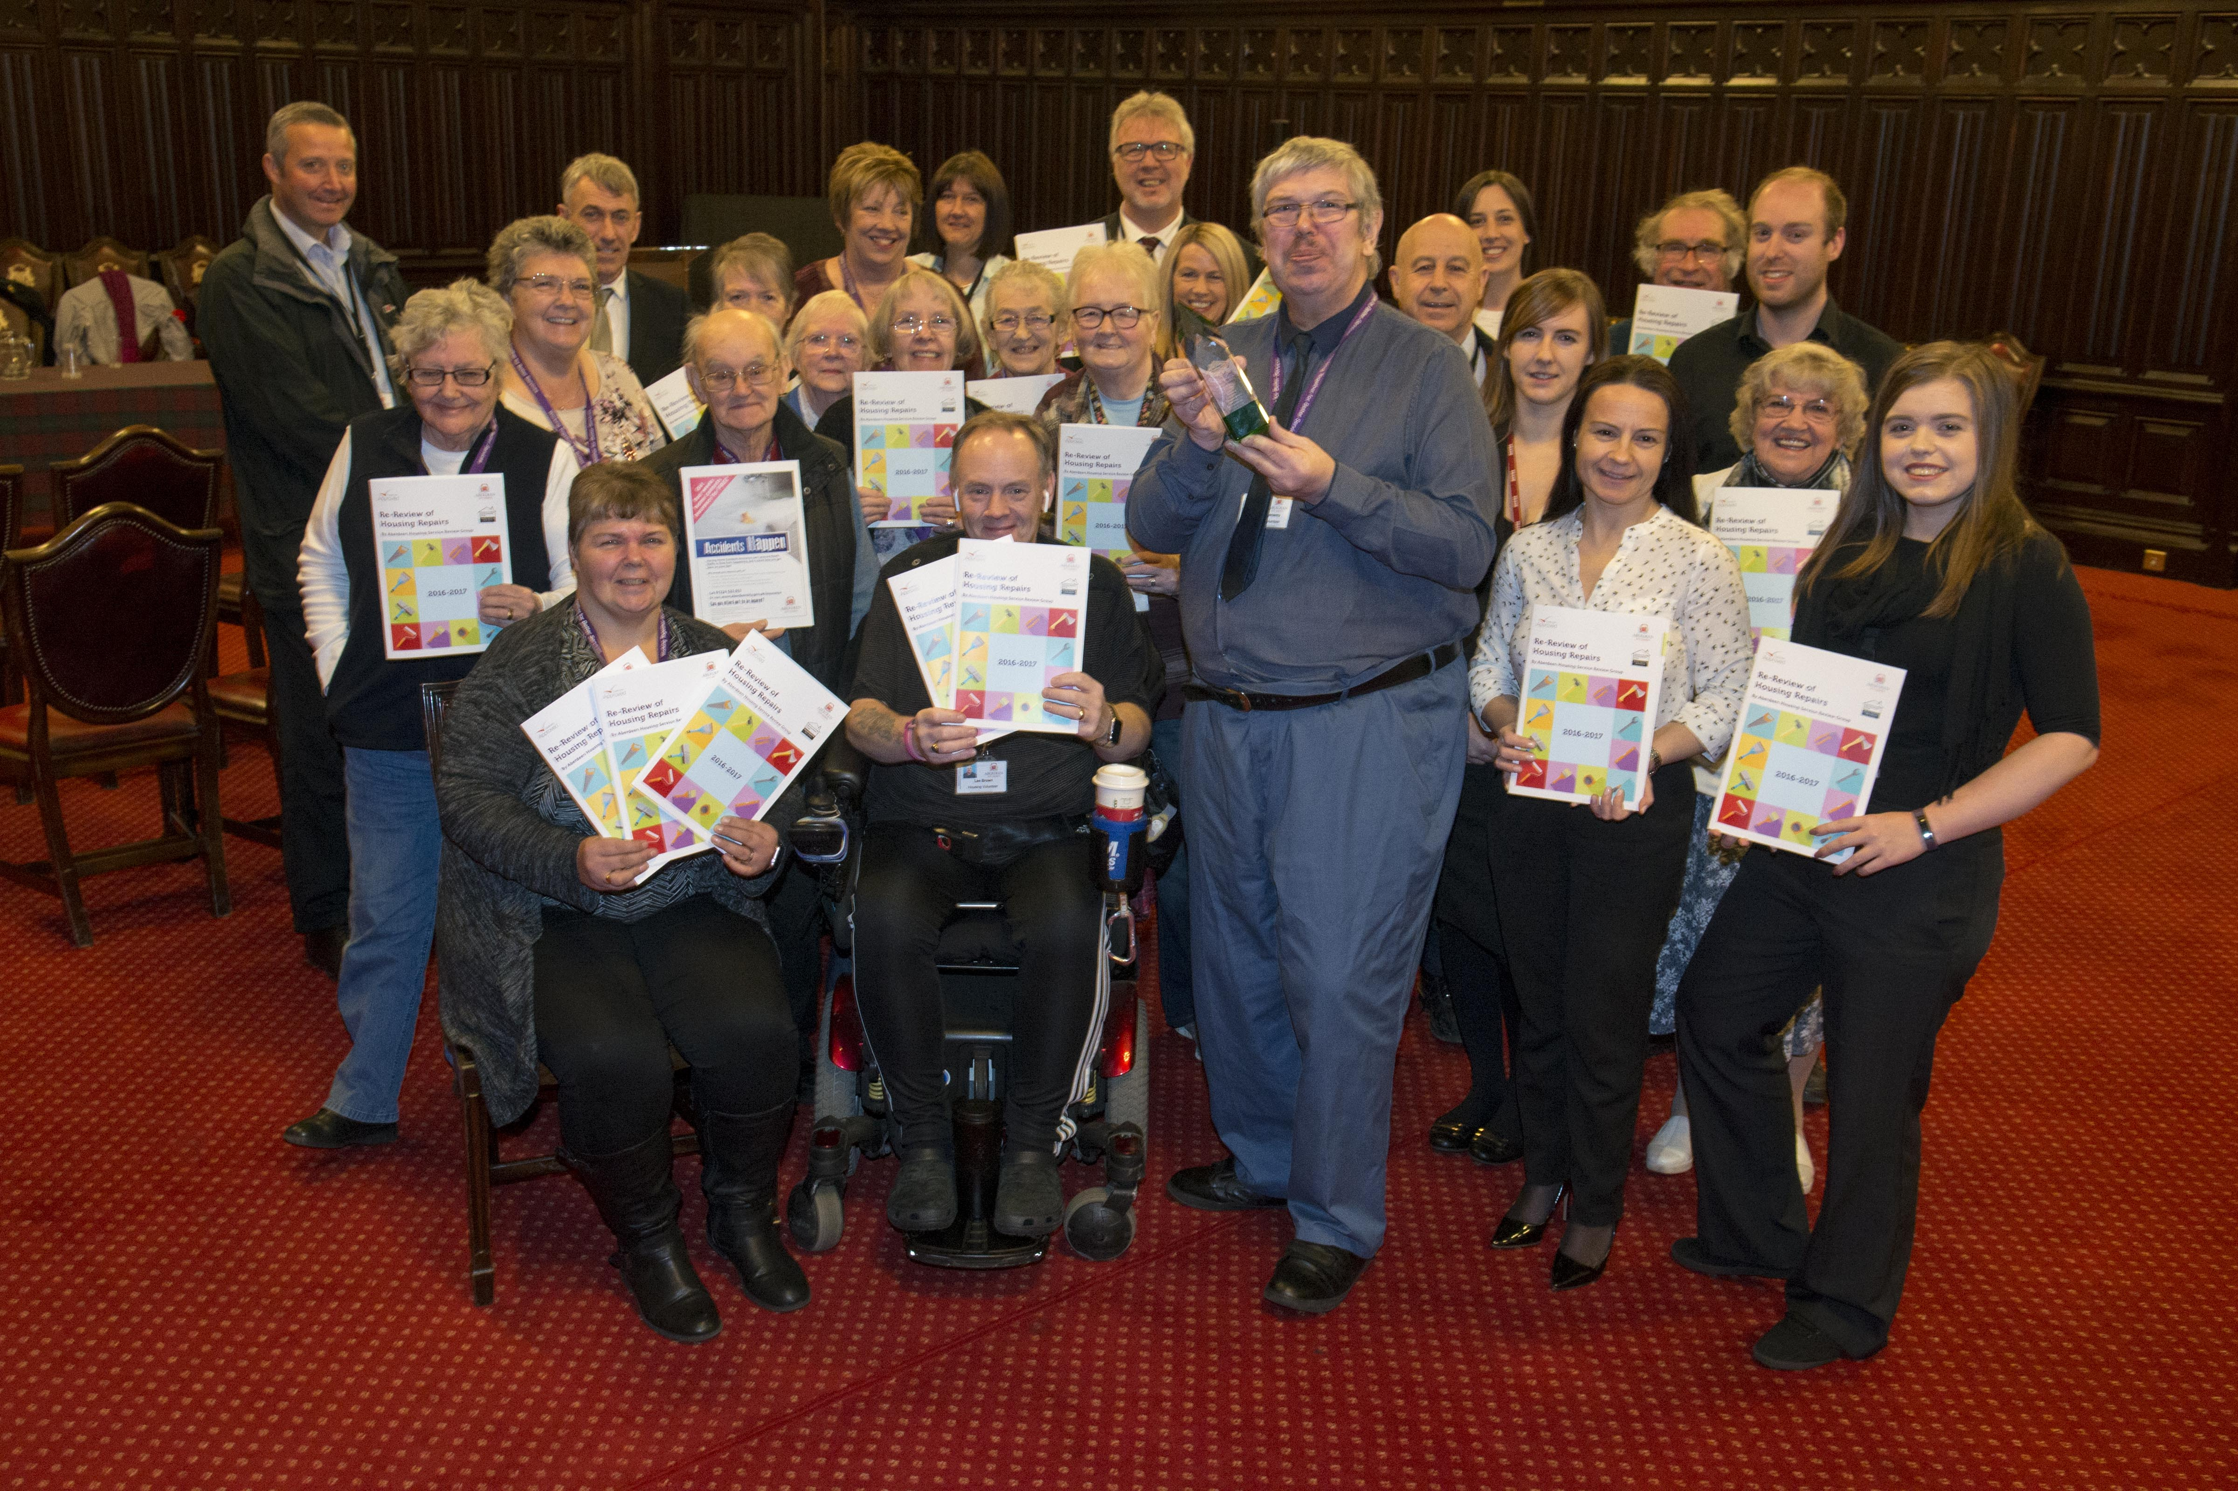
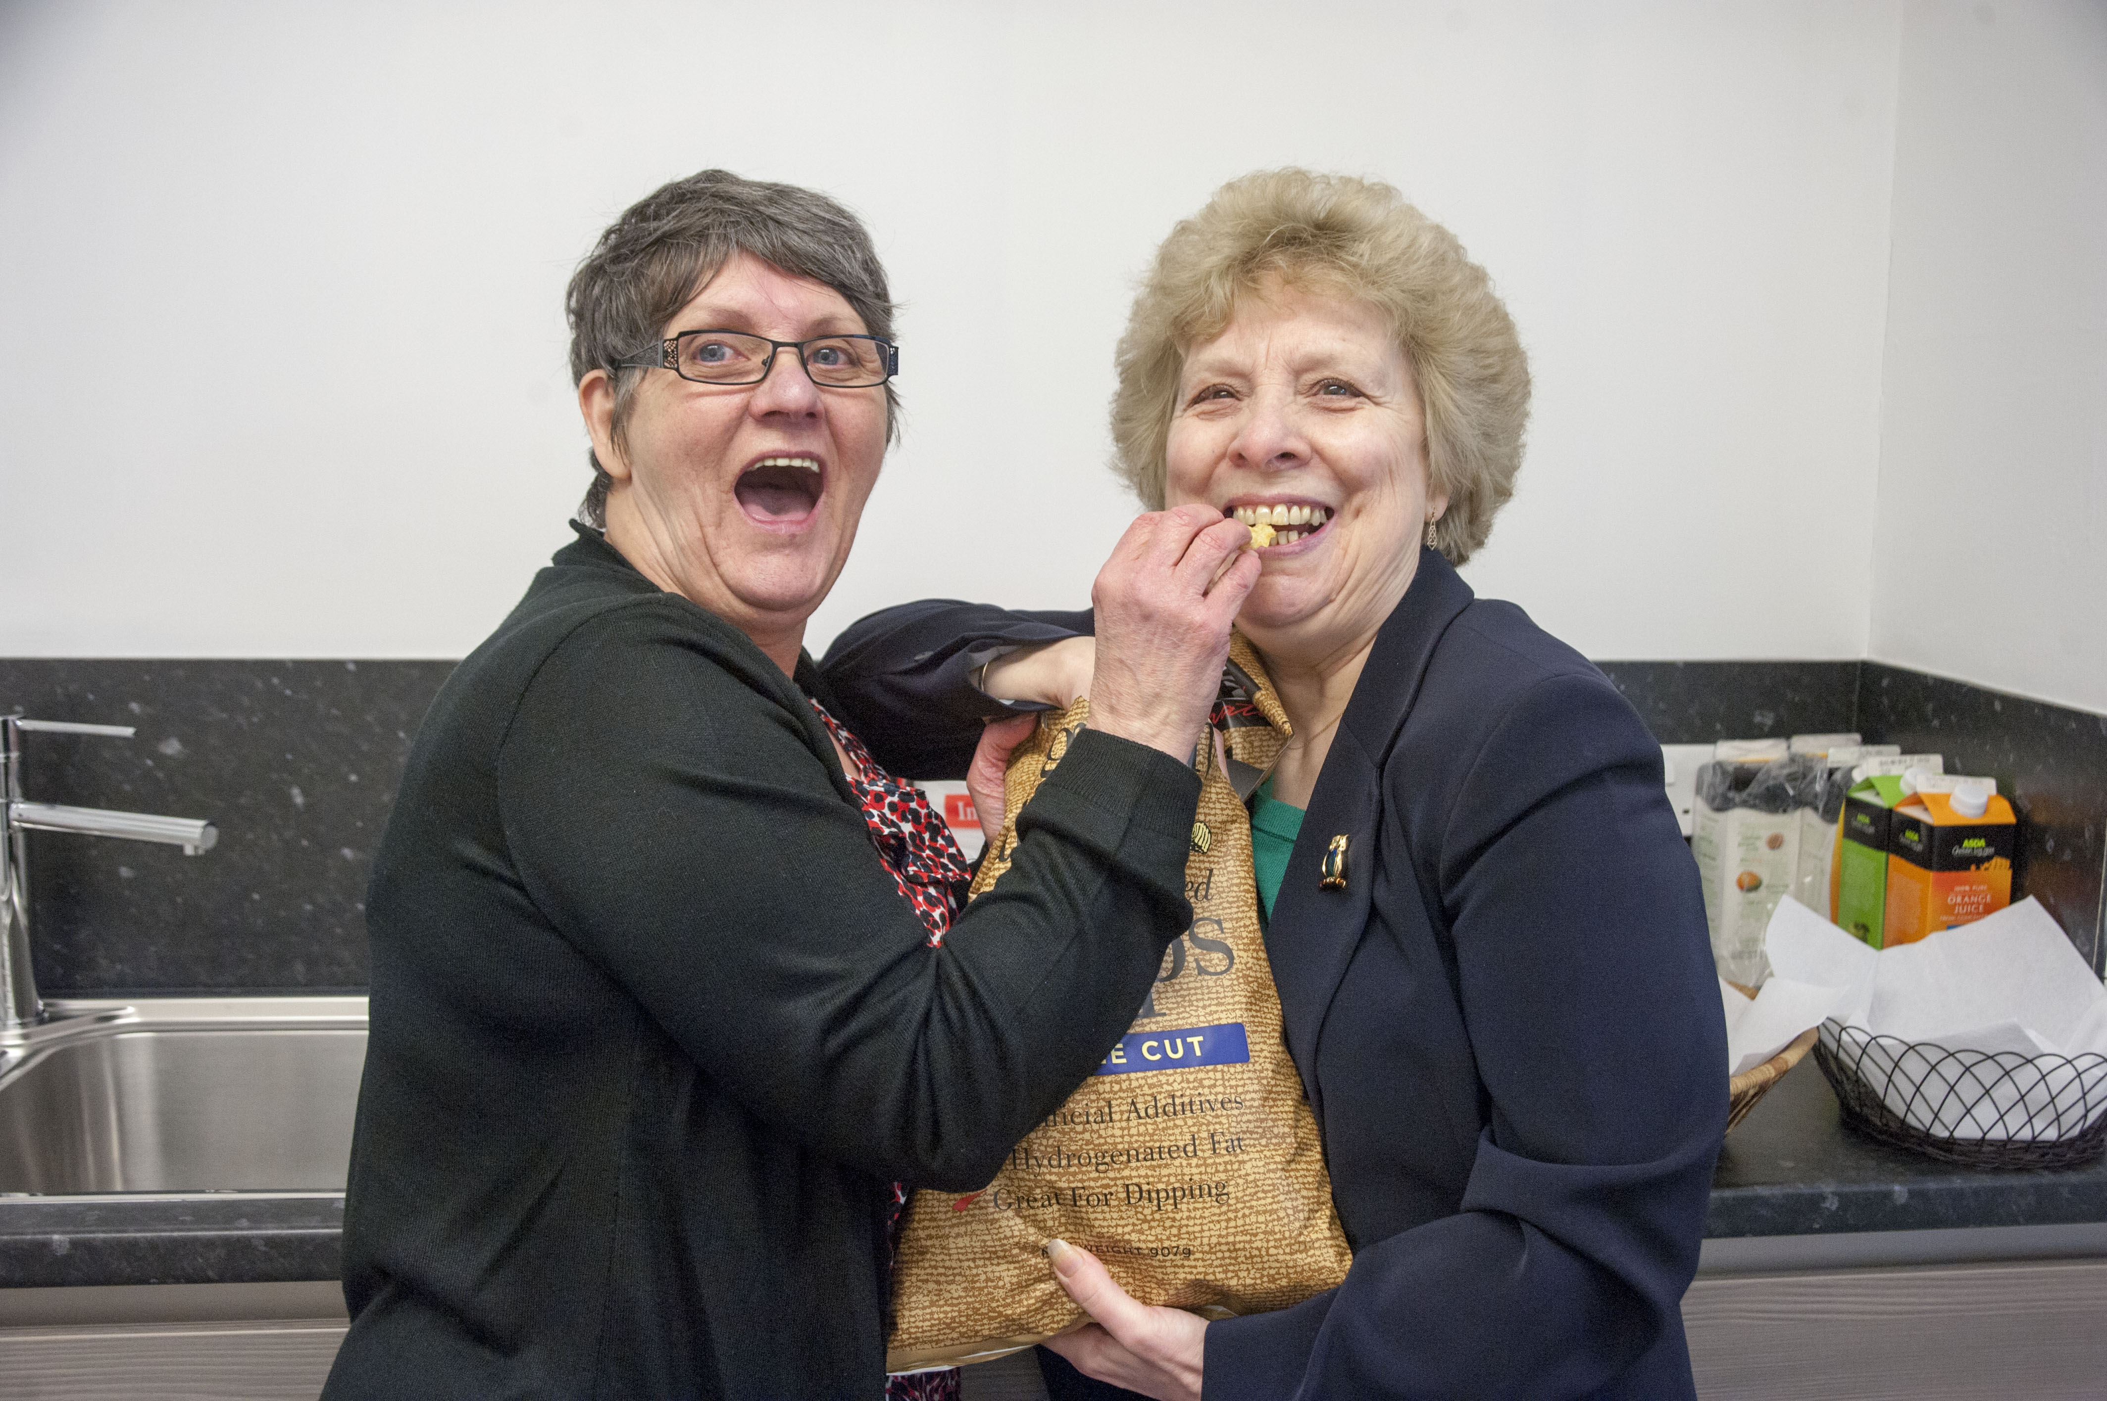
The Launches

Slide 8
When Things went Wrong
Massive impact on the Group as this was the first time, they had a negative service
Covid
First review on Teams
Members only on Telephone
Training online
Bye in from staff online
Service short staffed
Did not answer emails
Chief Officer got covid
Staff working from home
No answer to emails and invitations
Action plan
One staff member turned up to launch

Slide 9
Getting back on Track
Massive impact on the Group moral as reviews had been seen as positive
New Chief Officer for Customer Experience
Chief Officer for Landlord
Service Manager for Landlord Services
Lunch with the Group
Said sorry
Transformation of Asset Management Service
Commitment to support the Group
Next Review has begun

Slide 10
The Successes
What would make you Come through the door?
Buy in from the top and our services
Reviews seen as positive in the organisation
Recommendations of the Group built into service plans – 2way process
Services communicate with each other more
“What would make you come through the door”
Recognition for the Group & the Council
Reviews promoted by Group all over Scotland
Know how to deal with no buy in - negativity

Slide 11


Thank you from Carol & Fay

