Slide 1

Participatory Budgeting
Laura Cameron
laura.cameron@moray.gov.uk
Notes:
Good morning, my name is Laura Cameron and I work at the council. I’m part of the communities team which means I get to go out into the community and speak to people instead of staying in my office all day which I really like about my job.
I’ve been asked to come out today to speak to you about participatory budgeting. Now participatory budgeting sounds really complicated but it’s not…

Slide 2
What is Participatory Budgeting (PB)?
Budget Identified
People vote for their priorities
The priorities with the most votes get funded
People come up with ideas on how to spend a budget
Notes:
One thing about participatory budgeting is that it’s quite difficult to say – so we just say PB sometimes because it’s easier.
PB means that if money is going to get spent on something to help a group of people those people should be allowed to share their ideas on how it is spent. But not only that, they should also get to vote on the ideas that they think would make the most difference to them.
The process looks a bit like this.
Sooo has anyone heard of participatory budgeting before?

Slide 3
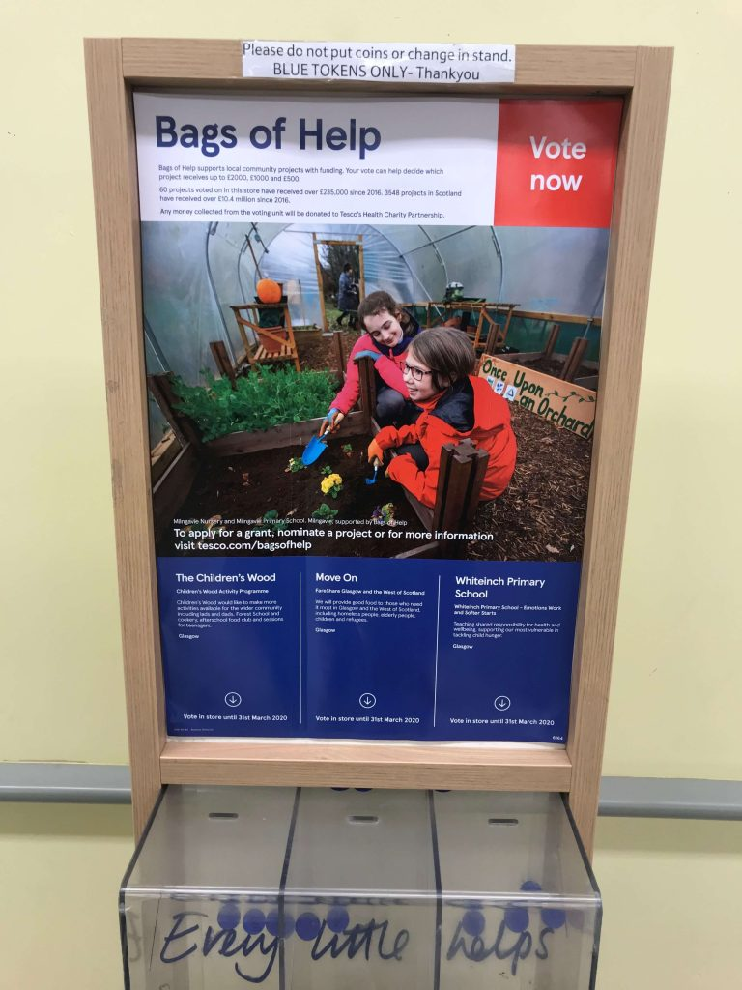
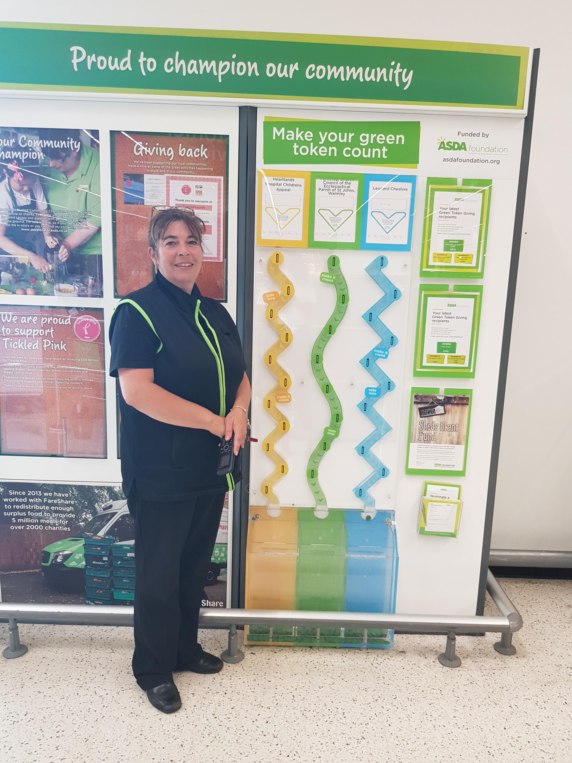
What is Participatory Budgeting (PB)?
Notes:
You probable recognise these two photos….It’s Tesco and Asda. Have you ever cast a vote by putting a token in one of the boxes?
So some of you have already taken part in a form of PB.
This particular PB process is where Tesco or Asda have a pot of money or sometimes they call it a community fund and they would like the community to tell them how to spend that money. They do it by opening up an application process asking groups and organisations for ideas on how they would spend the money, then there’s a vote because they want to give the money to the ideas that get the most votes, and they do that because they think that local people know best. And I think that too.

Slide 4
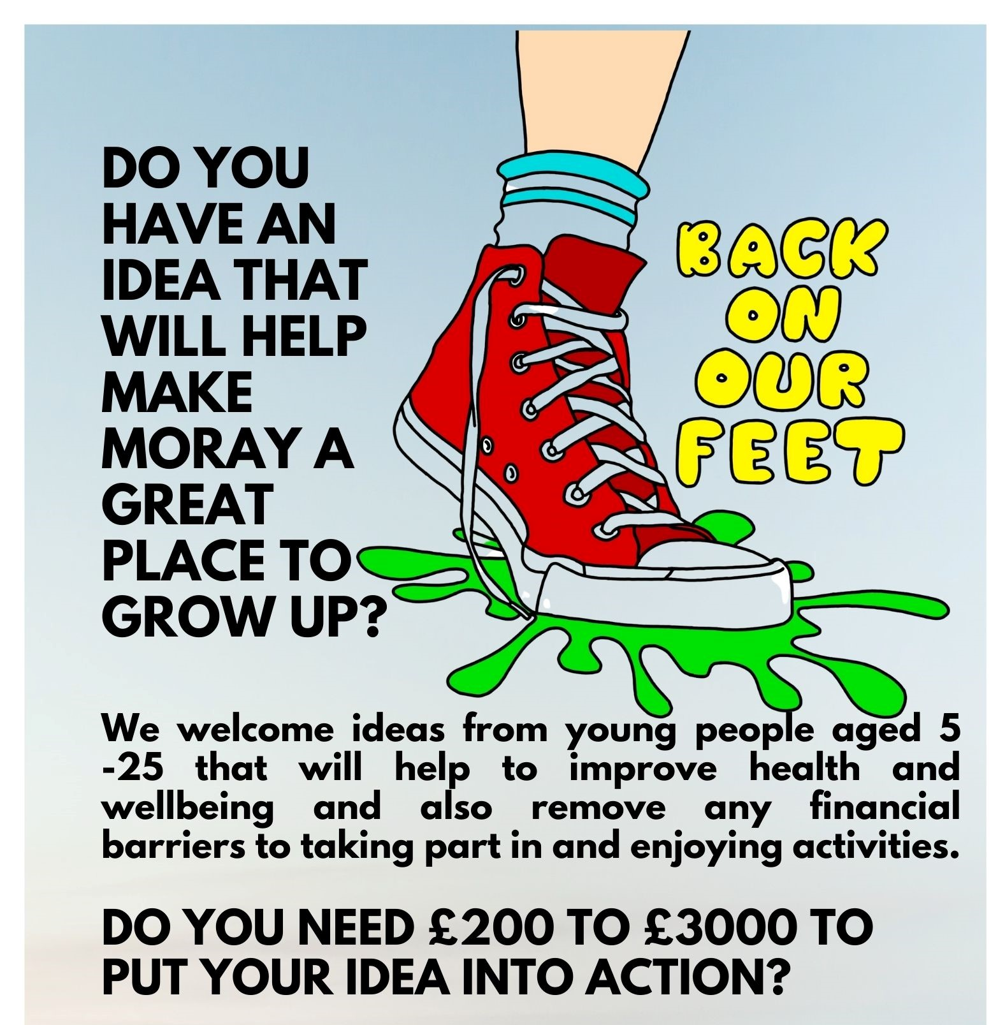



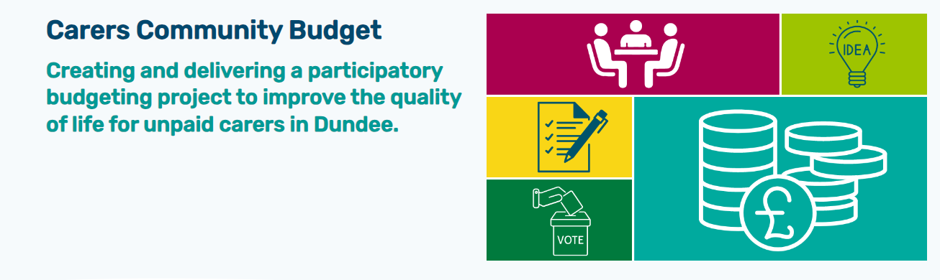
Participatory Budgeting in Scotland
Notes:
PB is happening all across Scotland. Sometimes the way it works is community groups receive money to deliver a project but sometimes the way it works is people suggest ways that the organisation or in my case – the council - can spend the money. That’s often called mainstream PB and I’m going to talk you through a mainstream PB project I’ve been involved with at Moray Council.

Slide 5
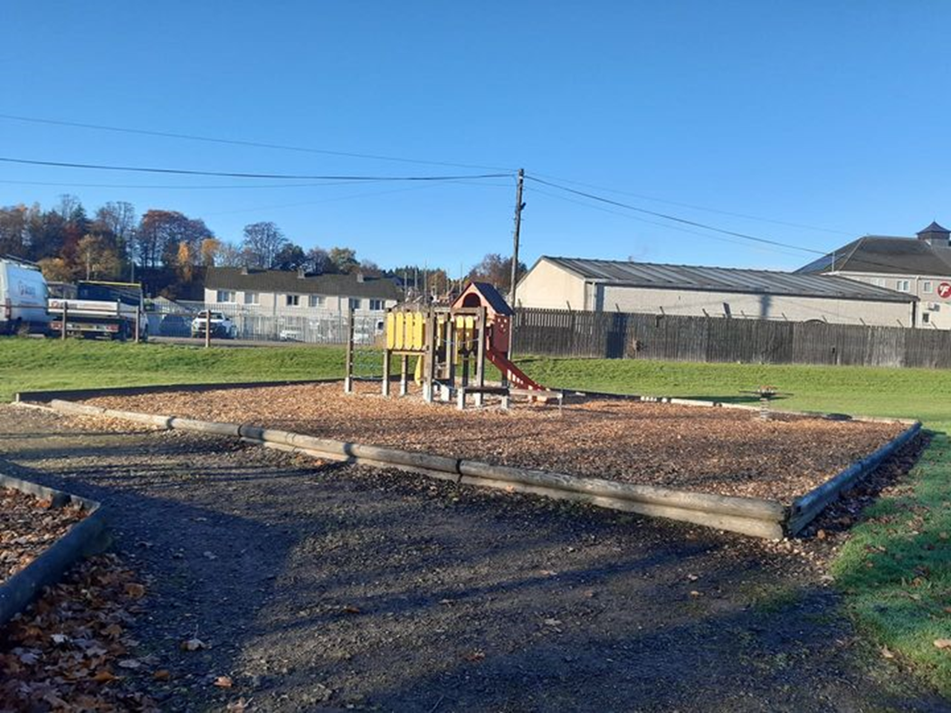
Rothes Play Park
Notes:
Here is Rothes Play Park. People in Rothes had approached Moray Council to ask that the local park be revitalized.
Through an independent inspection later on that year Rothes Play Area was then prioritized as being in need of improvement.
So Open Spaces through their capital improvement fund allocated £50k and they linked with our team to do a participatory budgeting project.
We were actually very lucky that when we responded to the people who had complained to say that budget had been identified - a small group had been discussing how they could action it already.
In our first meeting the group spoke really confidently about the park being a wonderful asset in the community for families including those on low income and without access to transport it was a much needed community asset because it provided an outdoor meeting space for people during lockdowns plural, some of the group were teachers on maternity leave so they had knowledge of the importance of play on a child’s development. But they didn’t rate the design of the park, it was a series of raised bark pits which meant some local families couldn’t use it because of mobility issues and they felt the original design excluded 5-9 year olds. Because of its age, it wasn’t well looked after and there was a lot of litter in the park.
So there were some cross cutting themes emerging from discussion around
• Addressing impacts of poverty.
• Improving mental health and well-being.
• Addressing social isolation and helping people to reconnect.
We formed a mini steering group to take the project forward.

Slide 6
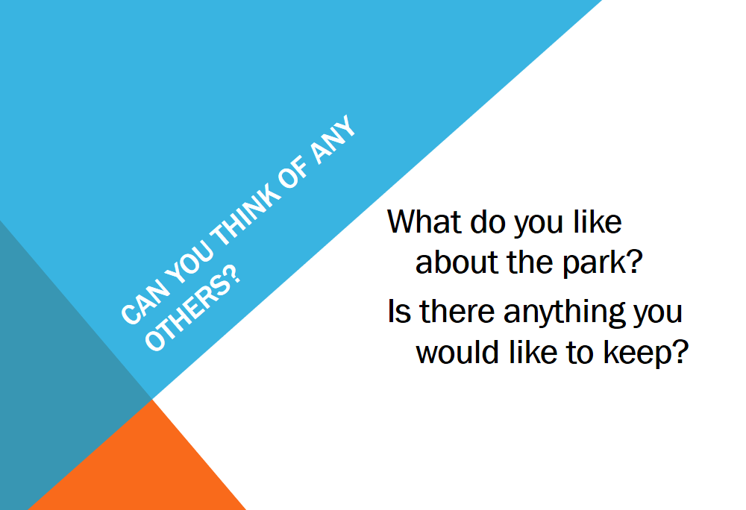
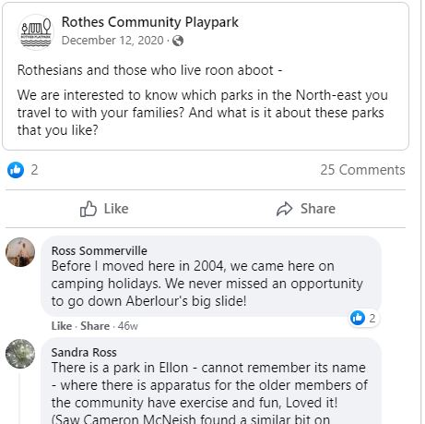
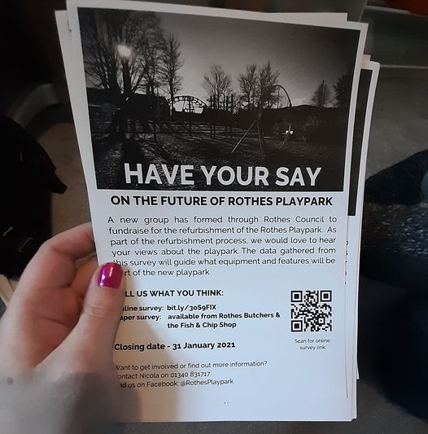
Information gathering
Notes:
We wanted to involve the whole community in how the park should be improved because they were going to be the people who used it.
Here’s just some of the engagement we did –we got wider community views through a survey which was available online and in paper form in local retail facilities (butchers and fish and chip shops). The community steering group designed the survey with support so we had open questions and some that were more specific to favourite pieces of equipment and favourite parks nearby.
A powerpoint and info pack which was offered to schools and the local nursery to help facilitate discussion with children. So thinking about those barriers to participation, can we send our survey to a 3 year old? No. Can we get their teacher to ask them what their favourite thing to do at the park is? Or what their favourite thing to play on is? Yes. We had amazing support from the school and nursery staff as a partner as this happened during severe restrictions when we weren’t able to go into schools.
6

Slide 7
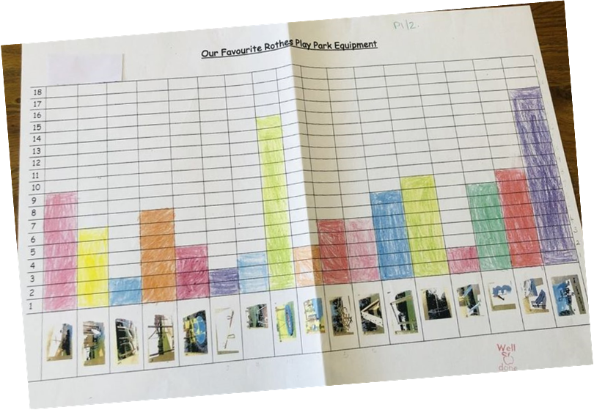
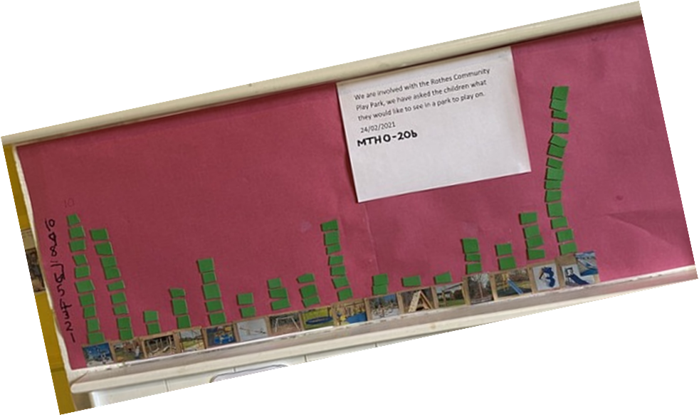
Information Gathering
Notes:
Analysis
There were about 120 survey responses plus almost a full primary school and nursery response. So more than 17% engagement with the population. Some of the feedback came in pre-analysed like these lovely graphs from Rothes Primary School.
The most expensive priorities that came from the engagement were resurfacing of the park and inclusive and accessible equipment. Rather unfairly those things are much more expensive. We did have conversations about whether there were other options around surfacing but accessibility was a major priority for the community and they weren’t put off.
So um we got to the developing proposals bit and then grew another wee leg out the side, because the community became really passionate about raising additional funds.
The capital budget needed to be spent within the financial year so the group had a fundraising deadline of 6 months which would still allow us to produce a tender (based on what funds were raised), get designs, do a community vote, award the contract and get a new park – phew!
7

Slide 8
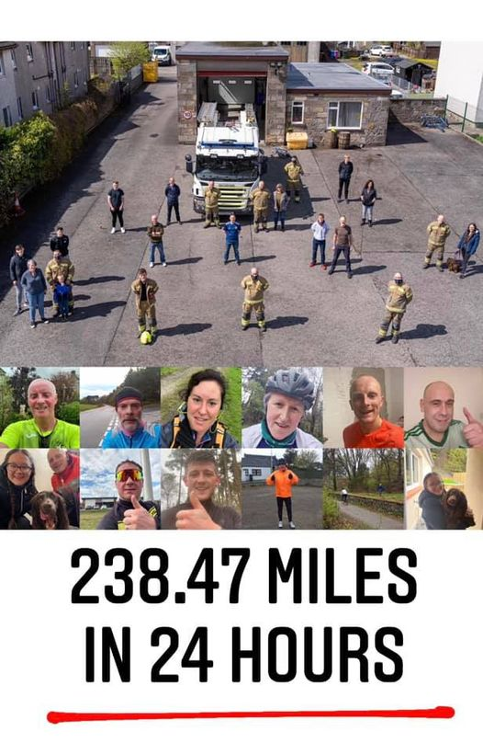
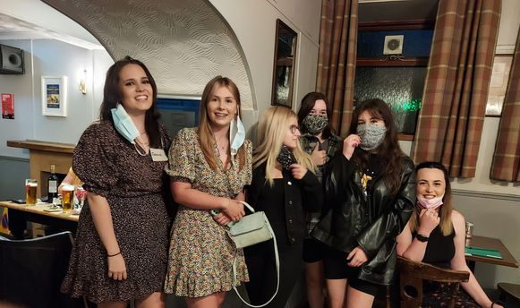
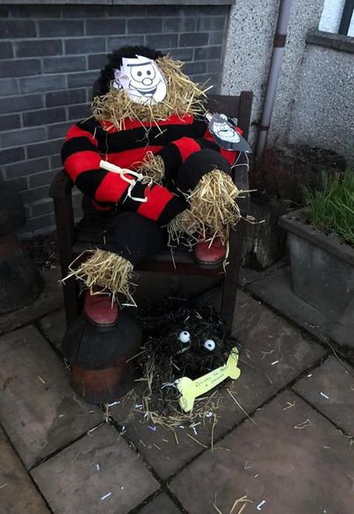
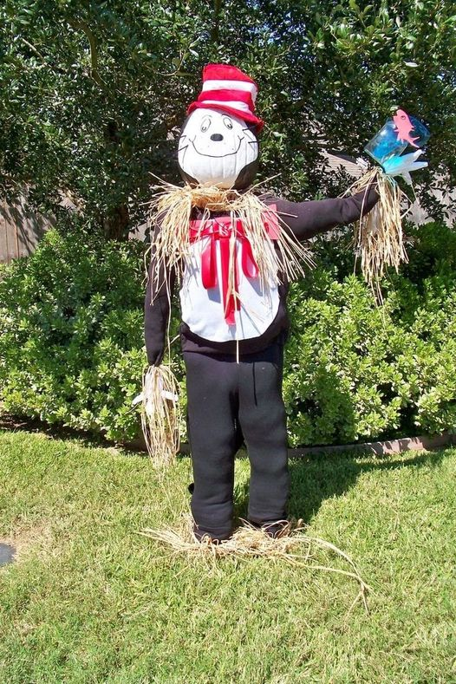
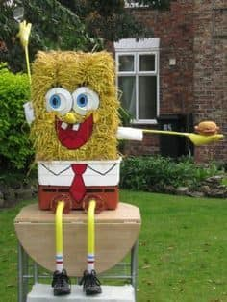
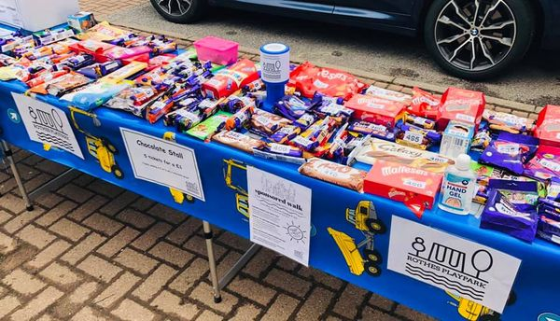
Funding
Notes:
Funding
Funding was achieved in the 6 month target. Yay! They actually raised £113k on top of the £50k. So they got funding for fencing, a picnic area and signage that were priorities identified during engagement but not within the remit of the local authority play improvement spend.
This community fundraising was really great for connecting people with the project and with each other. All other groups in Rothes at that time agreed to suspend their own fundraising for 6 months to allow the park to be the sole focus or beneficiary. That’s pretty amazing I think.
They applied for larger grant funding too and I think by the end they were expert funders.
8

Slide 9
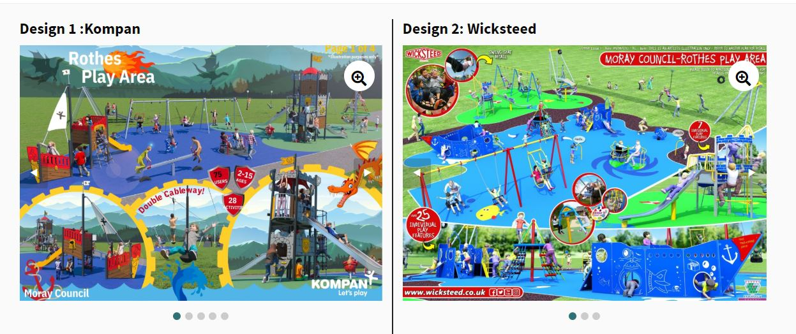
The Vote
203 votes cast
Notes:
WE drafted the tender together for £120k and two suppliers came back with design concepts.
203 votes were cast and the winner was design 1.
9

Slide 10
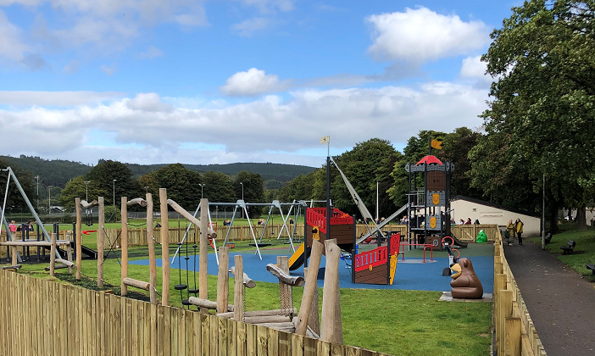
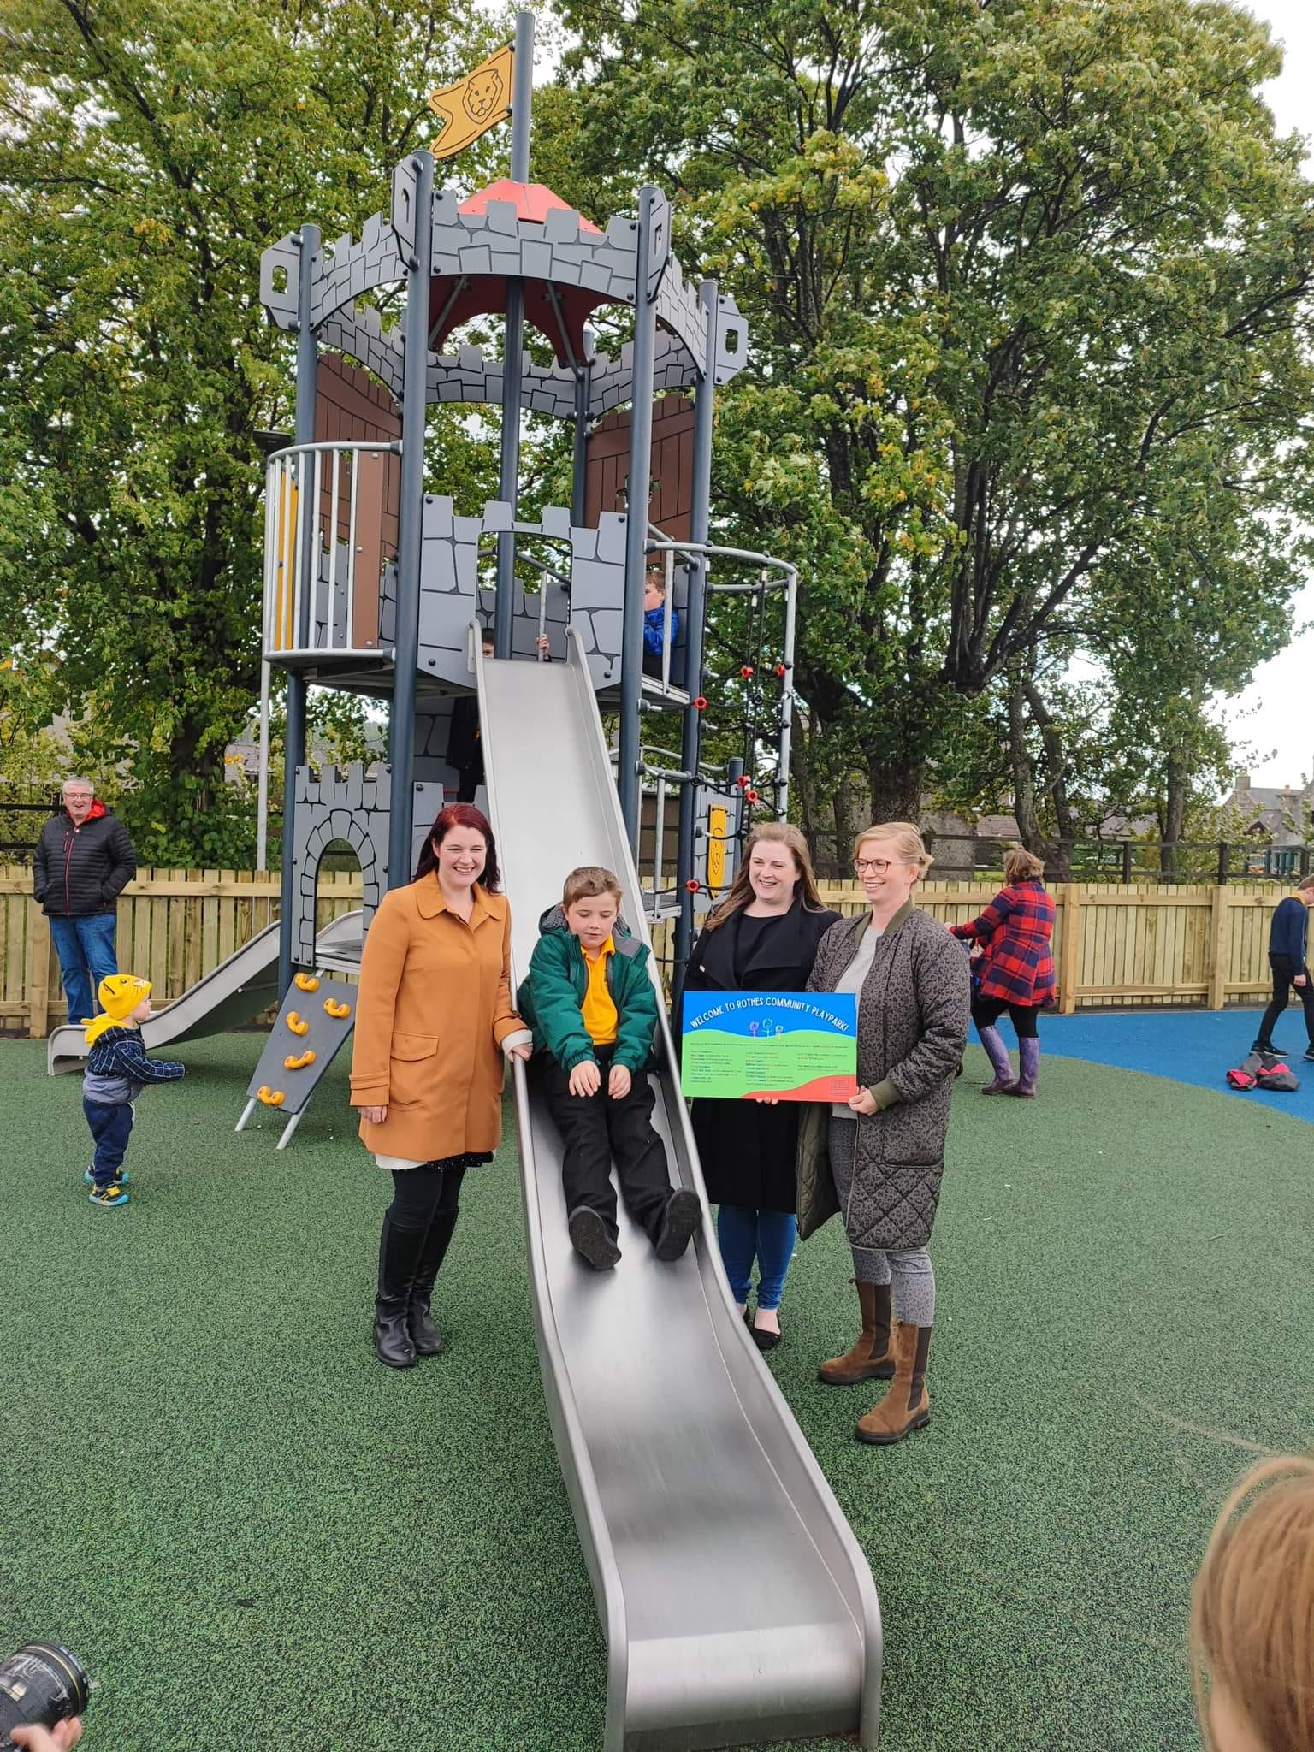
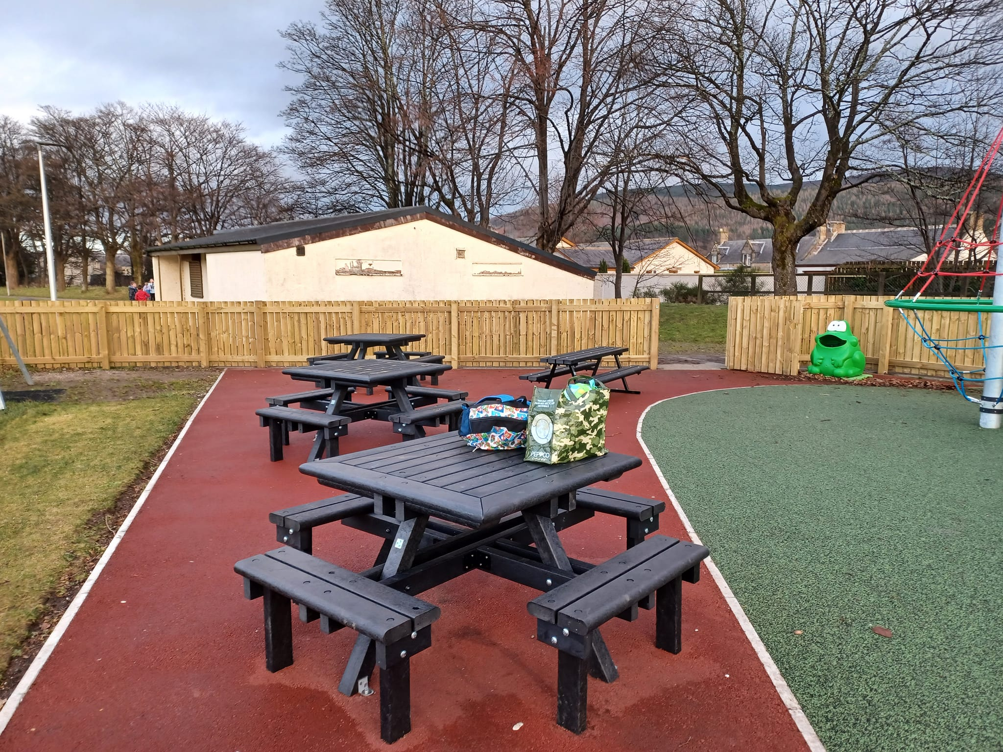
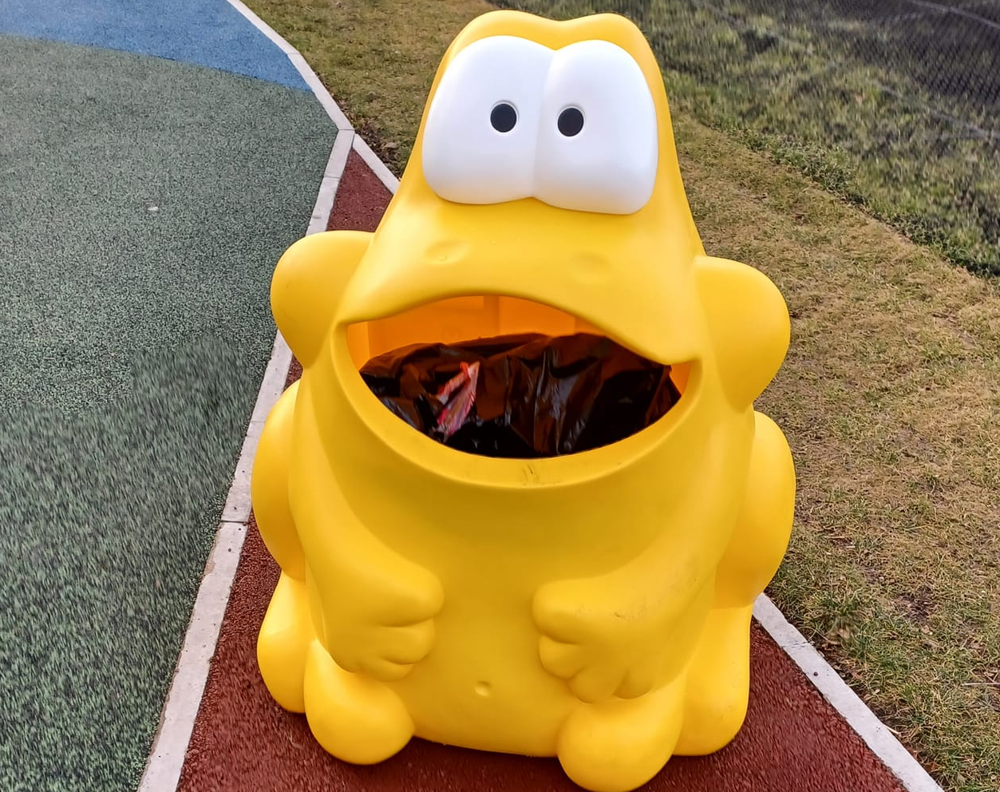
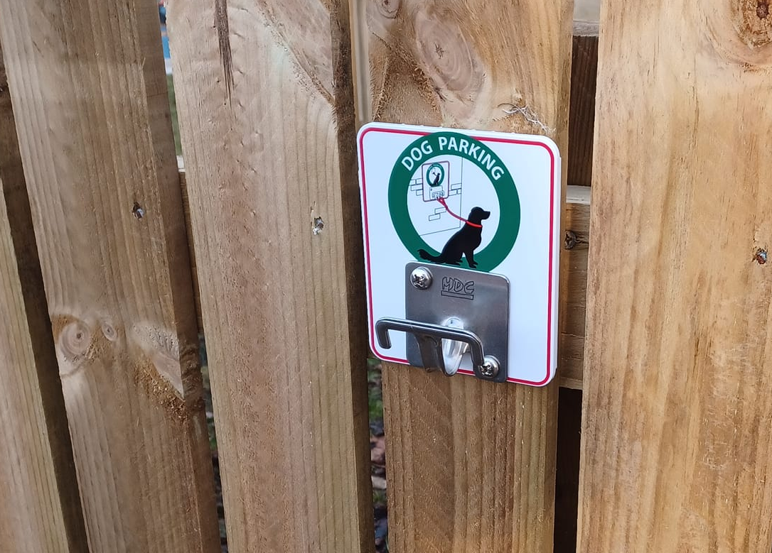
Rothes Community Playpark
Notes:
I couldn’t not share a picture of the park!
10

Slide 11
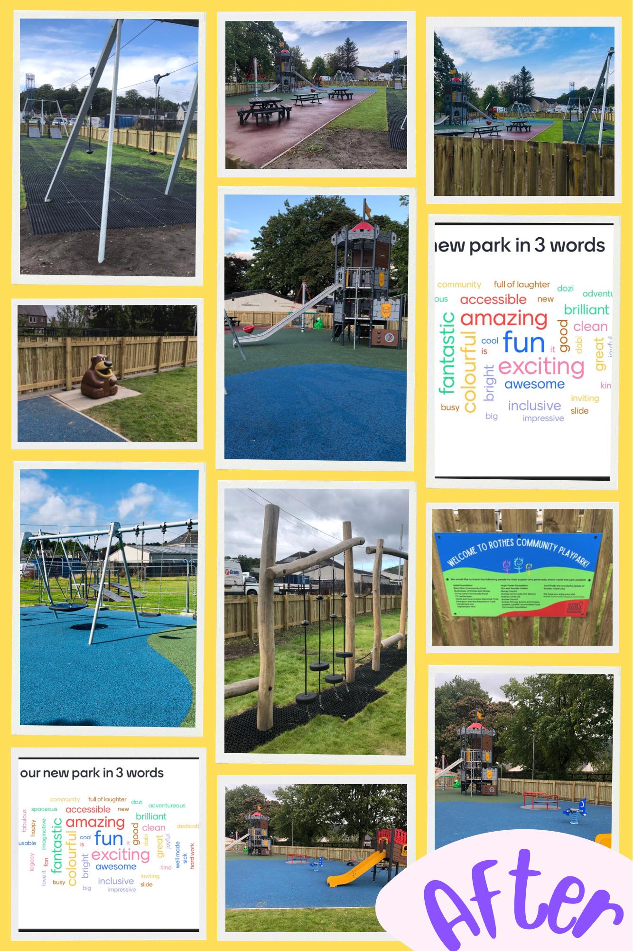
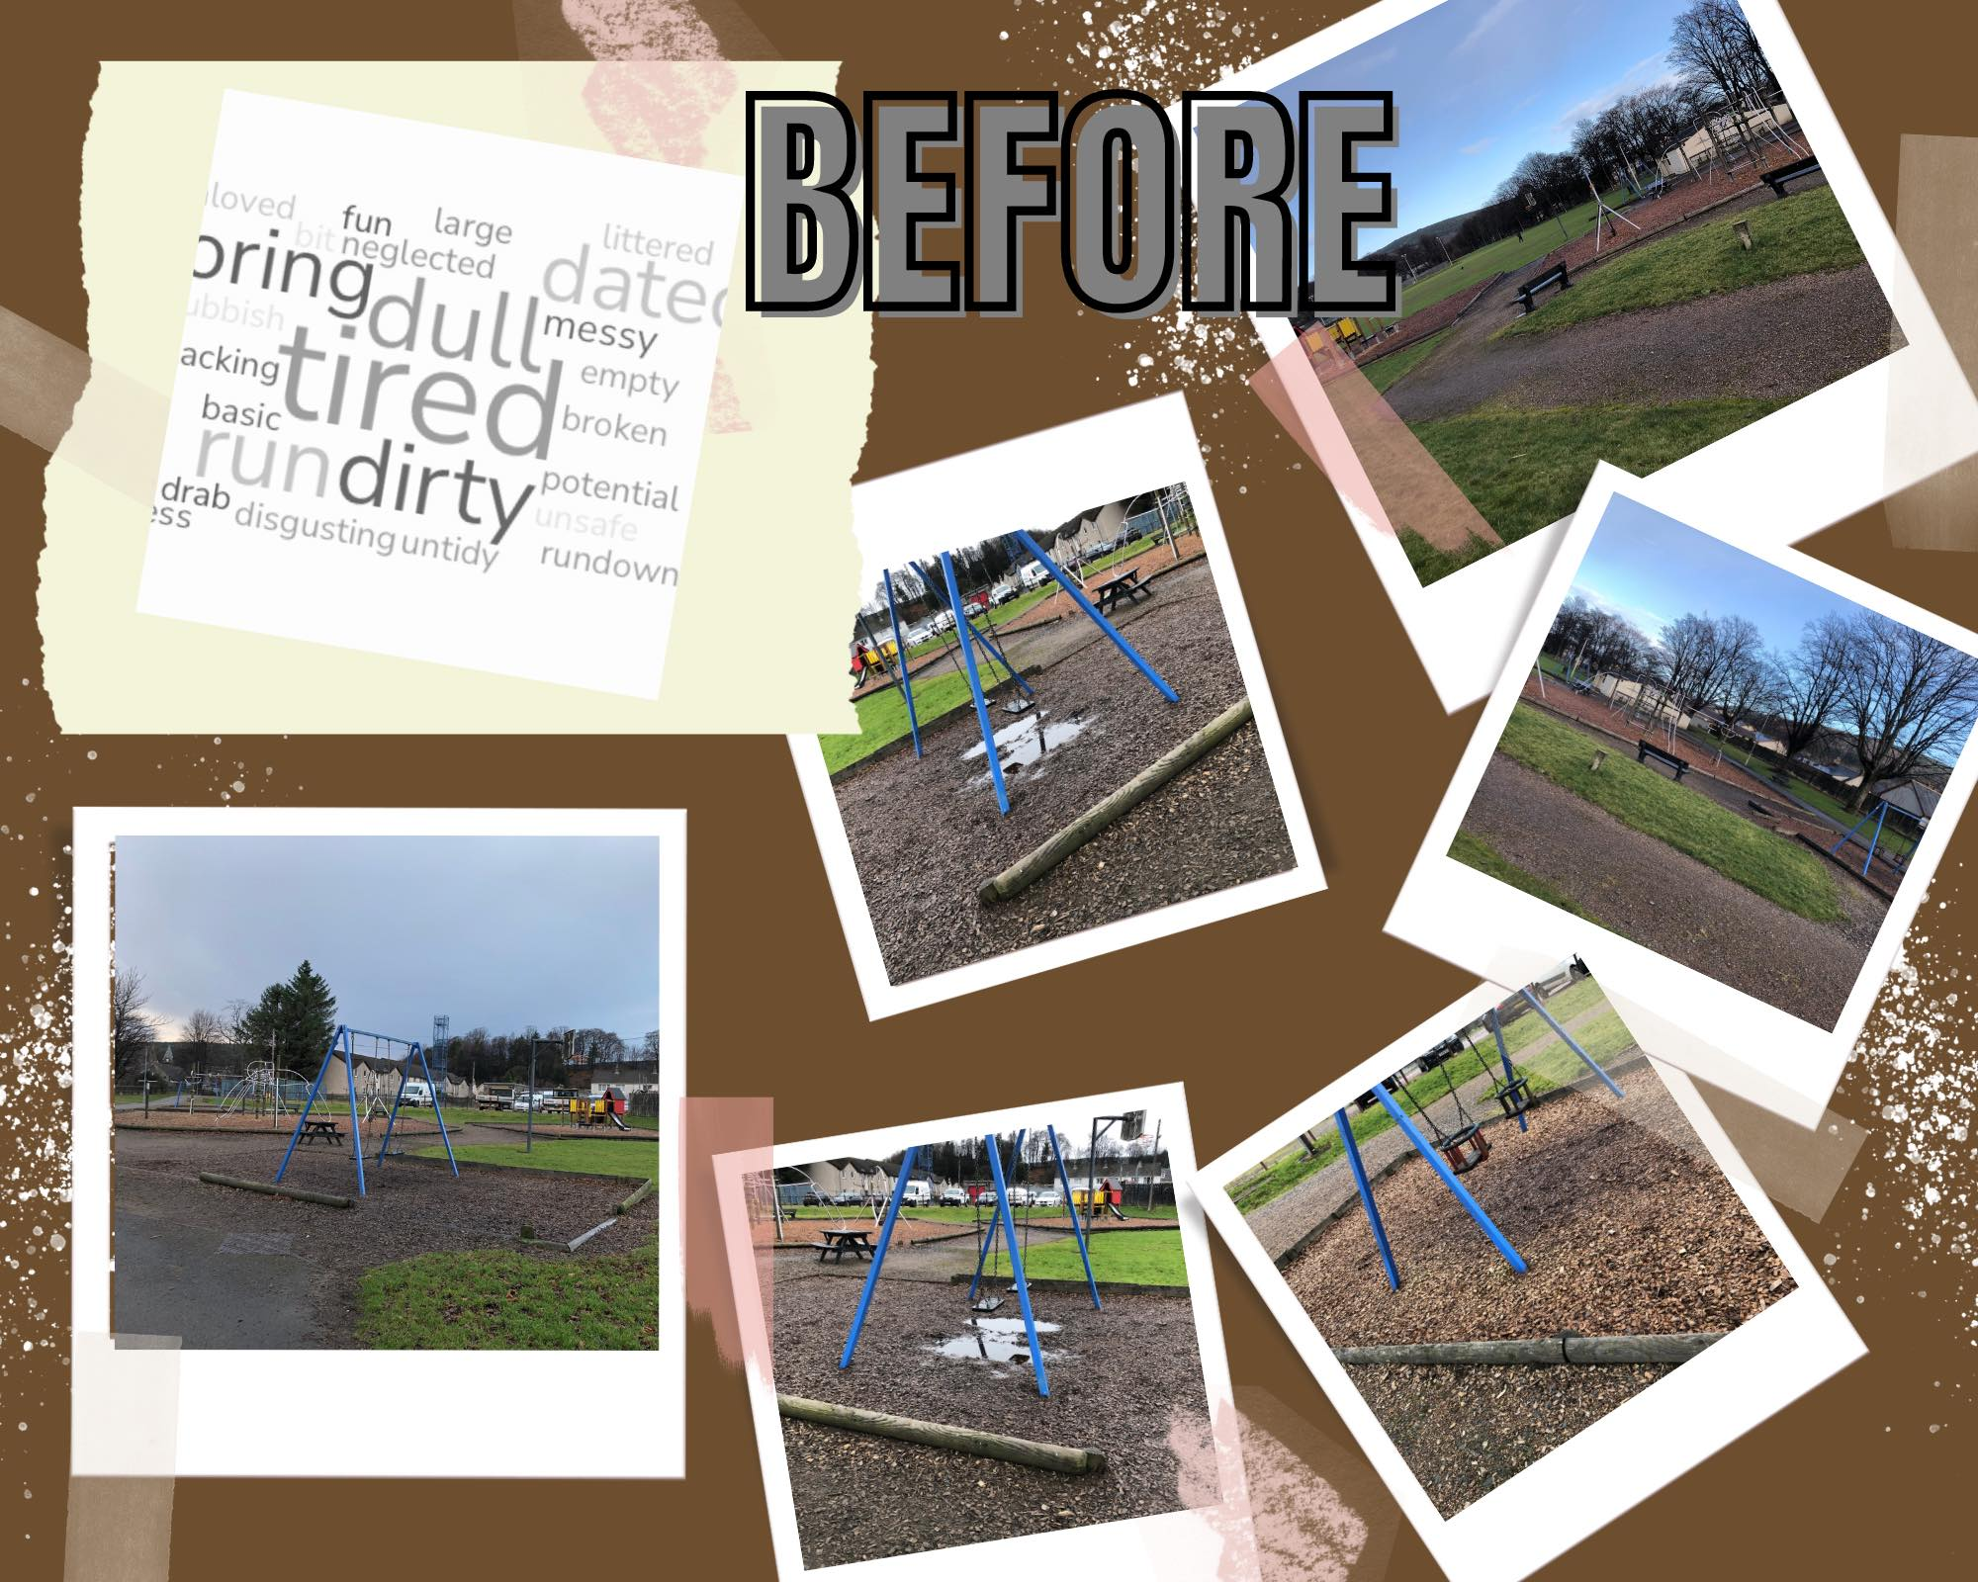
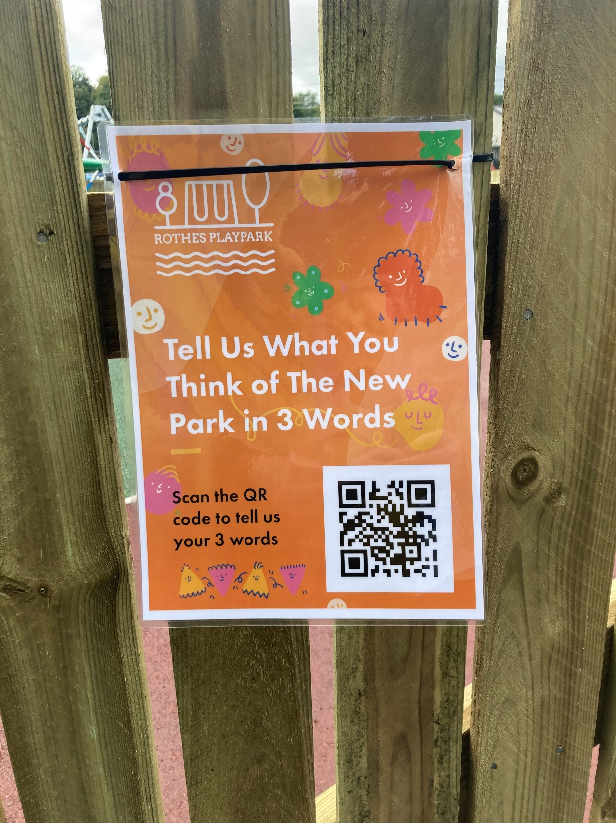
Community Evaluation
Notes:
Community Evaluation
We had spoken right at the very start about evaluating this project and the group had suggested doing a before and after picture diary, they admitted they hate doing evaluations but we agreed to ask for 3 words to describe the park when we did our original engagements and then on completion we could revisit those 3 words. It was a really simple way of showing that they had created change in the values associated with the park.
11

Slide 12
Participatory Budgeting in Scotland
Notes:
PB is happening all across Scotland. Sometimes the way it works is community groups receive money to deliver a project but sometimes the way it works is people suggest ways that the organisation or in my case – the council - can spend the money. That’s often called mainstream PB and I’m going to talk you through a mainstream PB project I’ve been involved with at Moray Council.

Slide 13

Laura Cameron, Community Support Officer – laura.Cameron@moray.gov.uk
Sandra McCallum, Community Support Worker – sandra.mccallum@moray.gov.uk

