Slide 1


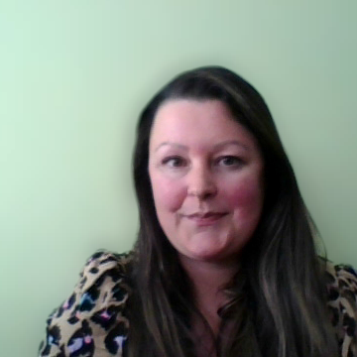
A guide to NETRALT & NTP
Presented by
Catherine Coutts, NETRALT Co-Chair
Notes:
Good morning and thank you all for joining us today. My name is Catherine Coutts and I am here to tell you all about the groups that have made today possible – Northern Tenants Partnership (known as NTP) and North East Tenants Residents and Landlords Together, known as NETRALT.

Slide 2
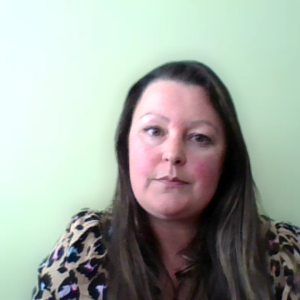
What is Tenant Participation?
”…a two-way process which involves the sharing of information, ideas and power. Its aim is to improve the standard of housing conditions and services”.
Legal framework
Scottish Social Housing Charter
Notes:
I think that most people here are already very familiar with this definition of Tenant Participation, but to understand why groups like NETRALT and NTP have come about, lets take a quick look at the legislation behind it. The Housing (Scotland) Act 2001 introduced a requirement that all Registered Social Landlords must have a Tenant Participation Strategy in place, which should be linked to current best practice and reviewed regularly. The Act set out a clear framework for tenant participation, but also recognised that good practice has an important role to play in ensuring innovative ways for tenant participation are considered.
The Housing (Scotland) Act 2010,introduced regulation and inspection across all Registered Social Landlords in Scotland, and with that came the introduction of the Scottsih Social Housing Charter. The Charter also sets out the standards and outcomes that landlords are expected to achieve, including tenant participation. Each year, every social landlord must complete an Annual Return on the Charter (ARC) to the Scottish Housing Regulator, followed by a Charter Performance Report to tenants later in the year.
So, the purpose of groups like NETRALT and NTP is to support registered social landlords to achieve these goals, and to enable us to provide tenants and residents with opportunities to participate.

Slide 3
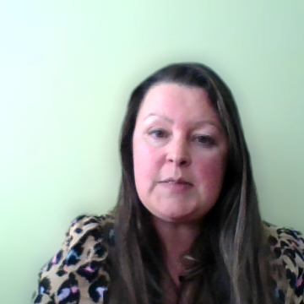
What is NETRALT?
A supportive partnership group to promote tenant participation
3 local authorities
5 housing associations
Meet every 6 weeks, hybrid
Notes:
North East Tenants Residents and Landlords Together (NETRALT) is a recognised tenant participation group. As our name suggests, members are tenants, residents and staff from social housing landlords and the group provides a platform to share good practice, offer best value and encourage and support its members, all with the overall aim of promoting and supporting tenant participation.
We have a diverse membership in terms of geographic locations, rural and urban settings and housing types like general needs, amenity, homes for older people - independent living, sheltered and very sheltered schemes all included.
We have 3 local authorities – Aberdeen City Council, Aberdeenshire Council and Moray Council.
And we have Castlehill, Grampian, Langstane Housing Associations, and Osprey and Blackwood Homes.
We meet every 6 weeks
Traditionally we always met in person and had a rota as to wich landlord’s office would be the venue for each meeting – we did this to try to make it more fair in terms of distance, travel time and accessibility. When lockdown happened, we had a head start as we had already been using on online platform called Basecamp to communicate between meetings for some years, and we started holding online meetings on Zoom, which our tenant members told us was much easier to use than Teams (which is what many landlords were using). Now that social distancing restrictions are no more, we have the best of both worlds and do hybrid style meetings. This gives members the choice of how they wish to attend and means that we are able to welcome tenants and residents who are not online.

Slide 4
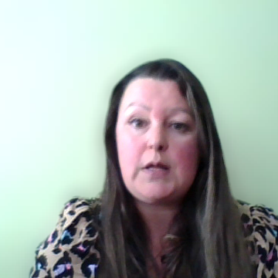
What is NTP?
Formed over lockdown to connect tenants and landlords
Similar concept to NETRALT
Covers the Highlands and Islands, Inner and Outer Hebrides, Moray, Orkney and Shetland
Meet quarterly, online
Notes:
Lets look at Northern Tenants Partnership. This group was created over lockdown to connect tenants and landlords to enable them to carry out tenant participation activities online, when social distancing restrictions made in person meetings and events impossible.
It covers a vast geographic area, including the Highlands and Islands, the Inner and Outer Hebrides, Moray, Orkney and Shetland., so you can see straight away the benefit of meeting online in terms of travel time and cost!
Northern Tenants Partnership has the same objectives as NETRALT and we are really happy to be able to share what NETRALT has done, and why – as we like to say in the tenant participation world, there is no need to reinvent the wheel, we are all trying to do the best we can so lets share good practice and support each other to do this.

Slide 5
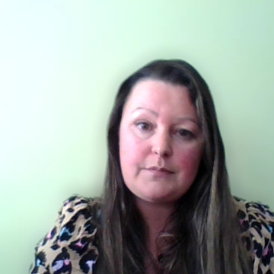
Strategy and action plan
Developed using Ketso technique
Everyone was able to be ‘heard’ – Ketso means you can write things down in addition to speaking
Fed into strategy and action plan
Reviewed by group
Notes:
So, we know why NETRALT started back in 2011 – we know the legal framework behind it, we know about being accountable to tenants via the Scottish Social Housing Charter, and we know that everyone is trying to achieve the same goals.
Everyone trying to achieve the same goals
Lets take a look at how we put this into practice. We realised that as well as having a constitution, we needed a framework to structure how we would do things. We wanted to have clear objectives to work towards, making sure that the activities we were doing are relevant and reflect good practice and current legislation.
NETRALT developed this strategy by holding a ketso session. I’ll try to explain the Ketso technique a bit – it’s a tried and tested, creative way to facilitate and record ideas, and it enabled us to ensure that every participant’s views were heard. It is a visual tool which can help different groups of people engage in proper dialogue and develop creative solutions together. So if you imagine a creating an image of a "tree" with its trunk representing the main topic or question, and ideas branching out, with detail added as leaves, that is Ketso.
That session formed the basis of our strategy.
I don’t have time today to go into the strategy in detais, but the next slides show it in action.

Slide 6
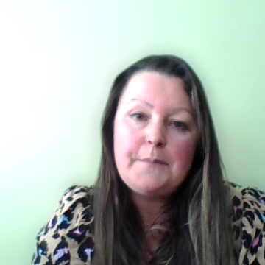
What does NETRALT do?
Multi-award-winning projects and members
Housing cafes
Events
Mystery Shopping
Youth Engagement
Built a network of community contacts to partner with
Notes:
This is a brief summary of the type of activities we do
some of you may have heard of housing cafes? Well, it was NETRALT who started them many years ago now!
We are delighted to have received national recognition for several of our partnership projects, including mystery shopping and youth engagement, which you’ll hear about later on today.
I’ll tell you a wee bit about some of our events

Slide 7
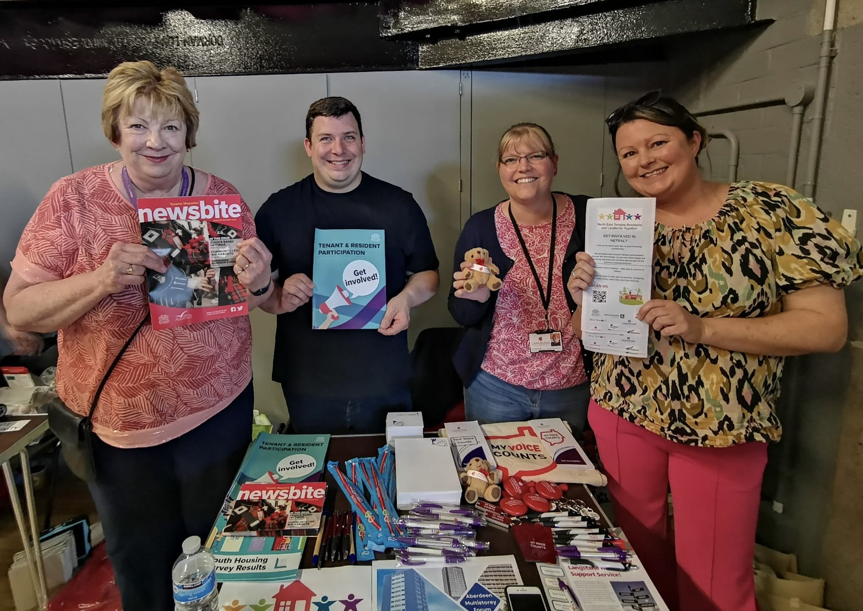
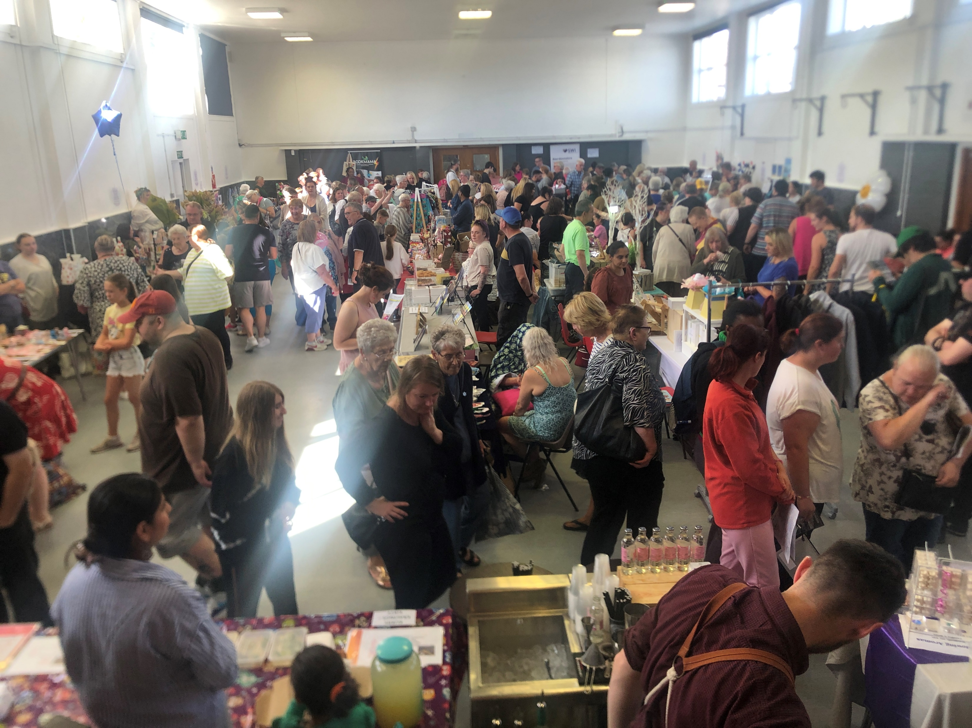
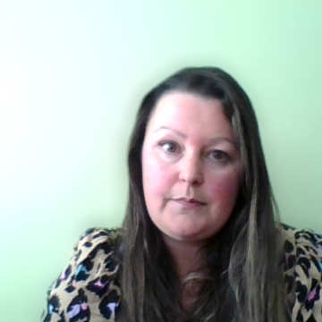
Community engagement events
Notes:
We want to get spread the word about Tenant Participation to as many people as possible. Our members have their own newsletters and websites, and these are great, but they don’t reach everyone so we team up and do it via NETRALT. We used to do create our own events and although these were good, we found them very resource-heavy – they take a huge amount of time to organise, and didn’t always have as much footfall as we would have liked. So now we team up with our community partners and whenever they have an event or an open day, we simply book a stall, turn up and speak to as many people as we can, rather than focusing on the logistics of running these events. We have managed quite a few this summer and have made more connections with people and community groups so agin we are able to reach out to as many people as possible and again expand our horizons for future partnerships.
The photos on this slide are of an event we went to at Inchgarth Community Centre in Garthdee – as you can see it was really well attended and busy .

Slide 8
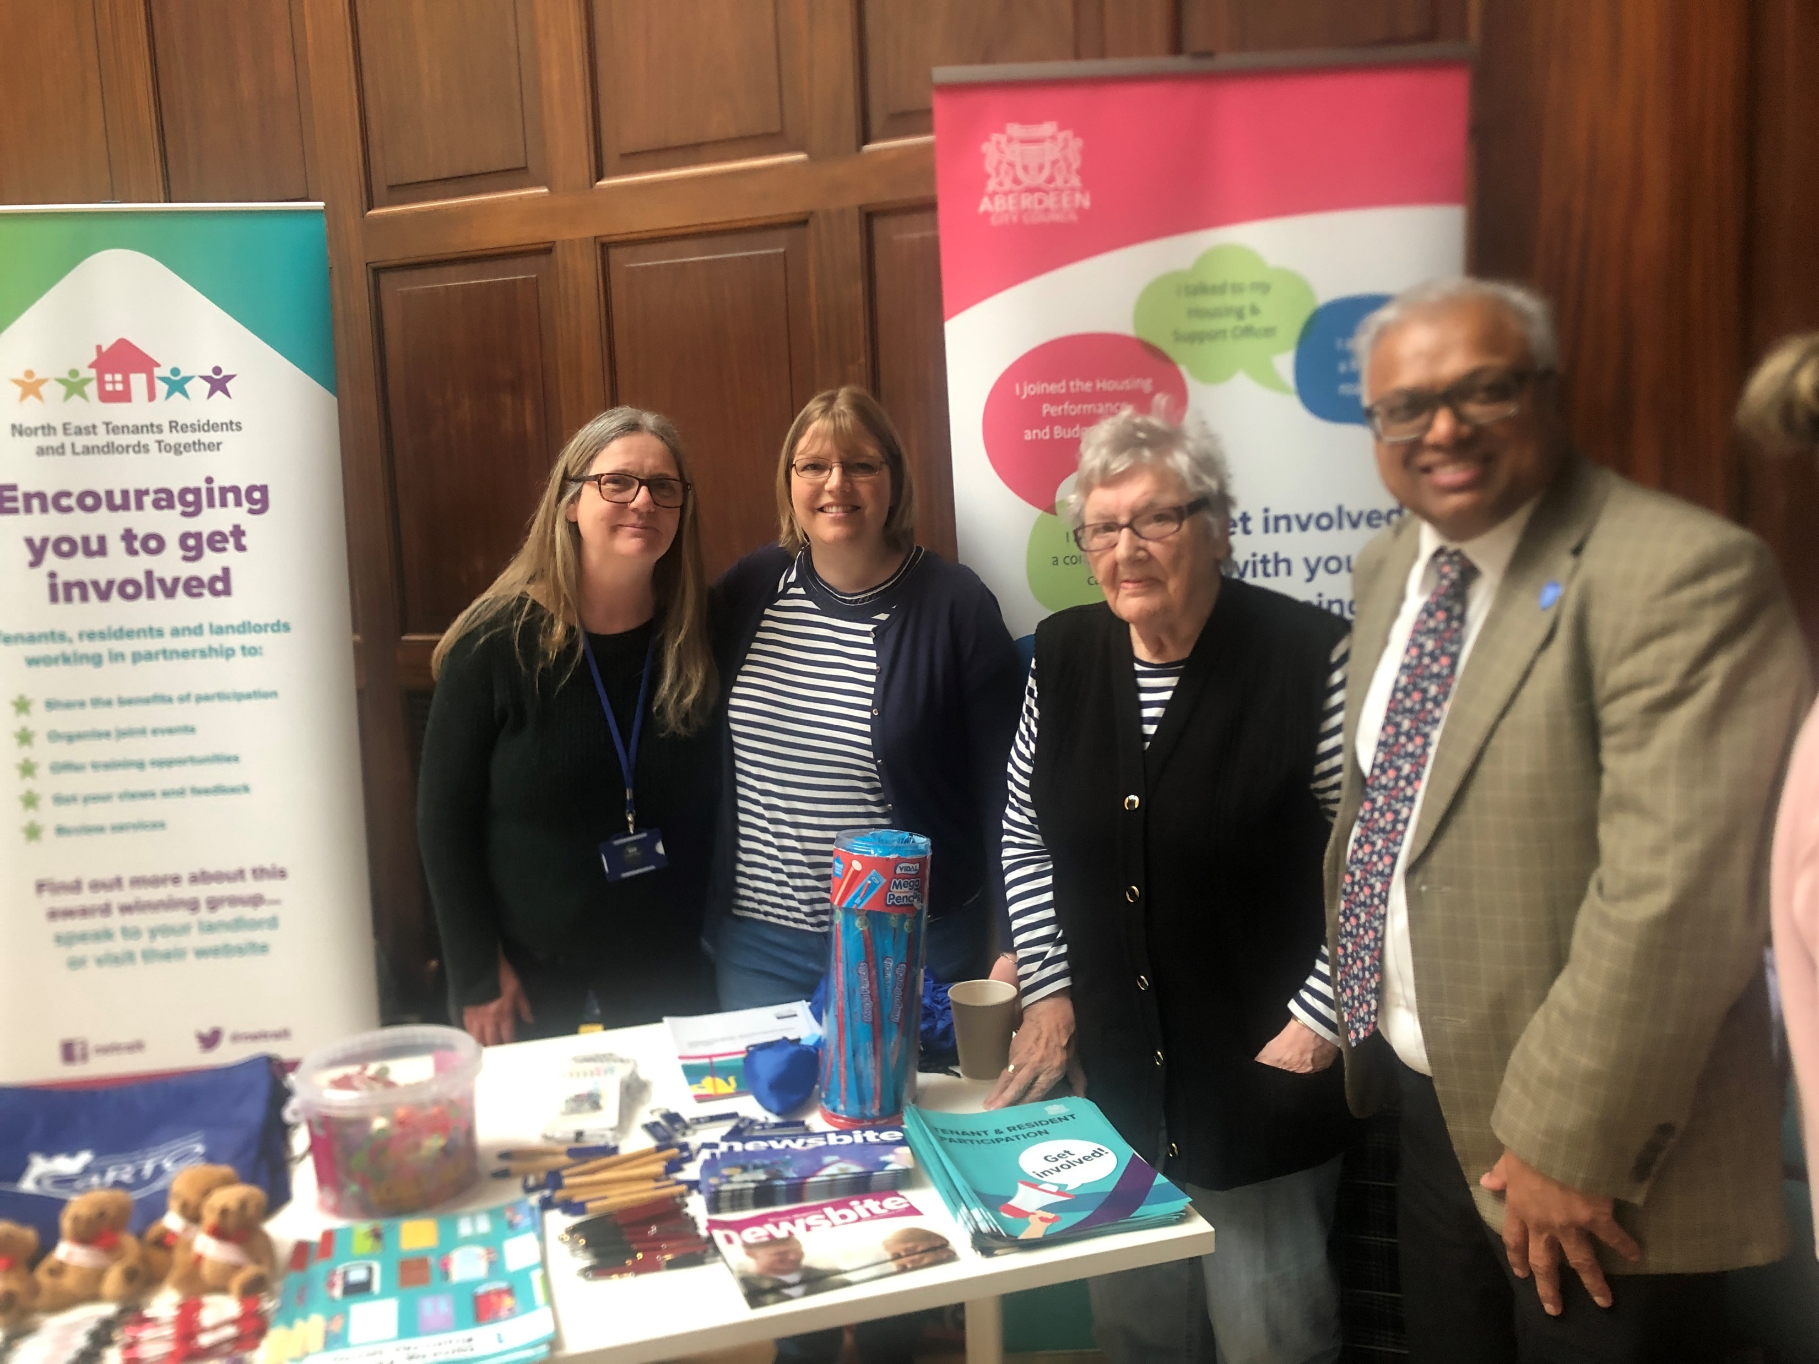
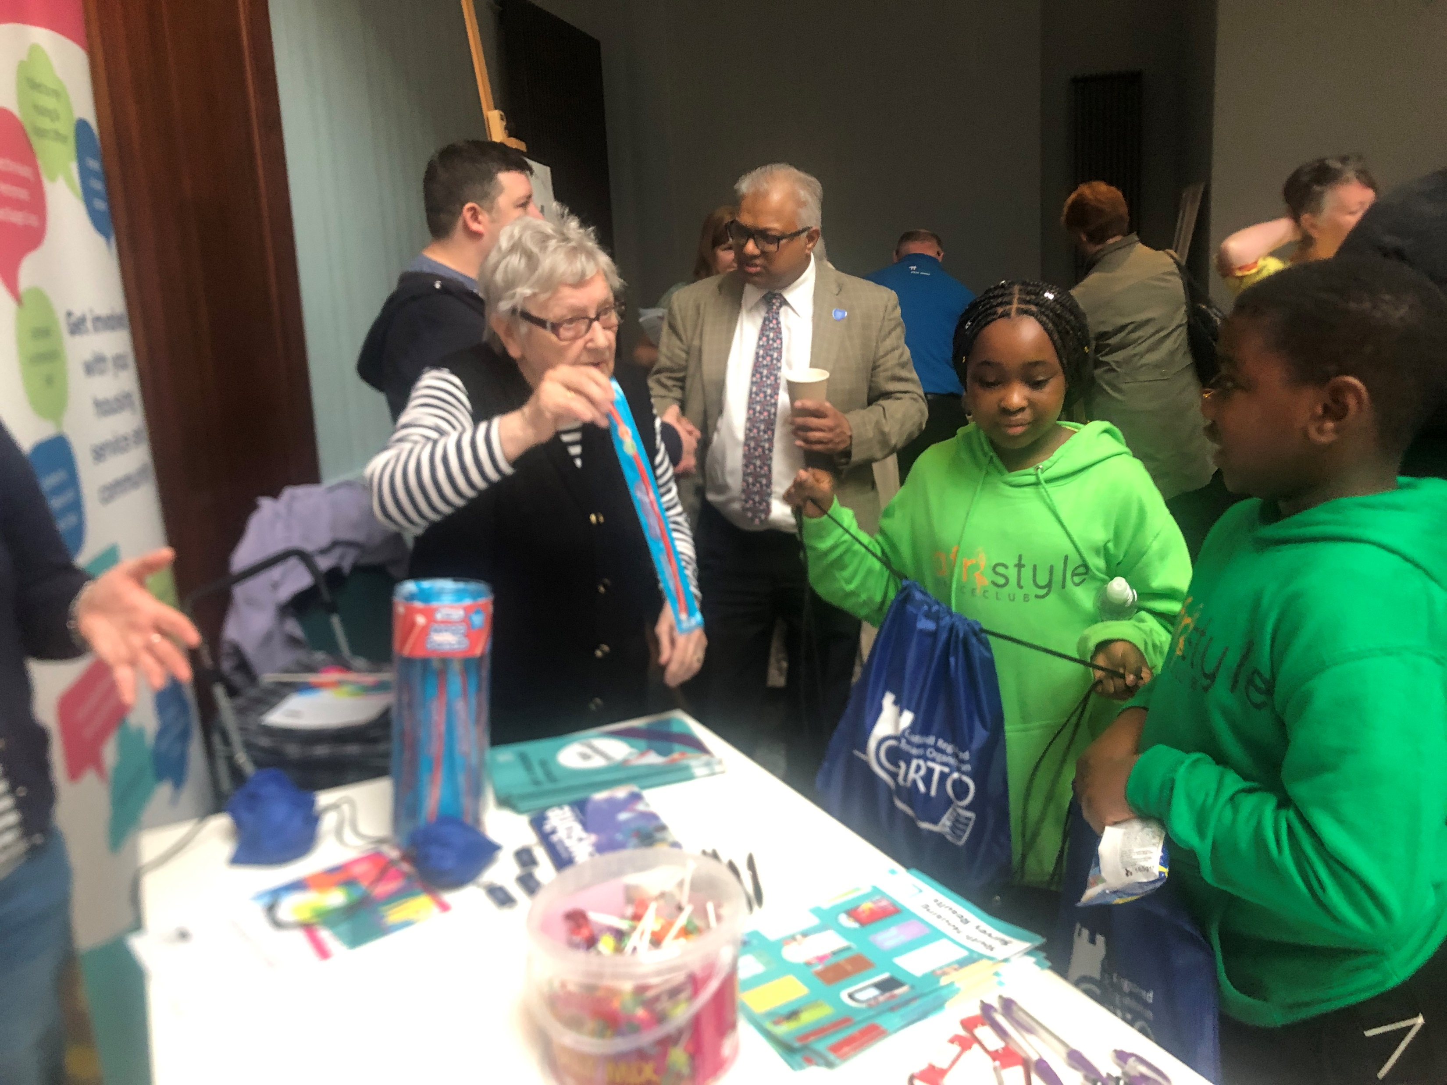
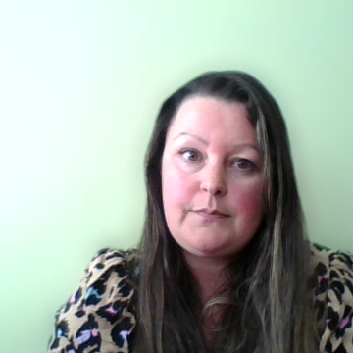
Community engagement events this summer
Notes:
These are some photo of another community event in the Cowdray hall in Aberdeen, which was really worthwhile going to and also a lot of fun. But the best thing was we just turned up and concentrated on promoting NETRALT and chatting to people about tenant participation and housing.

Slide 9
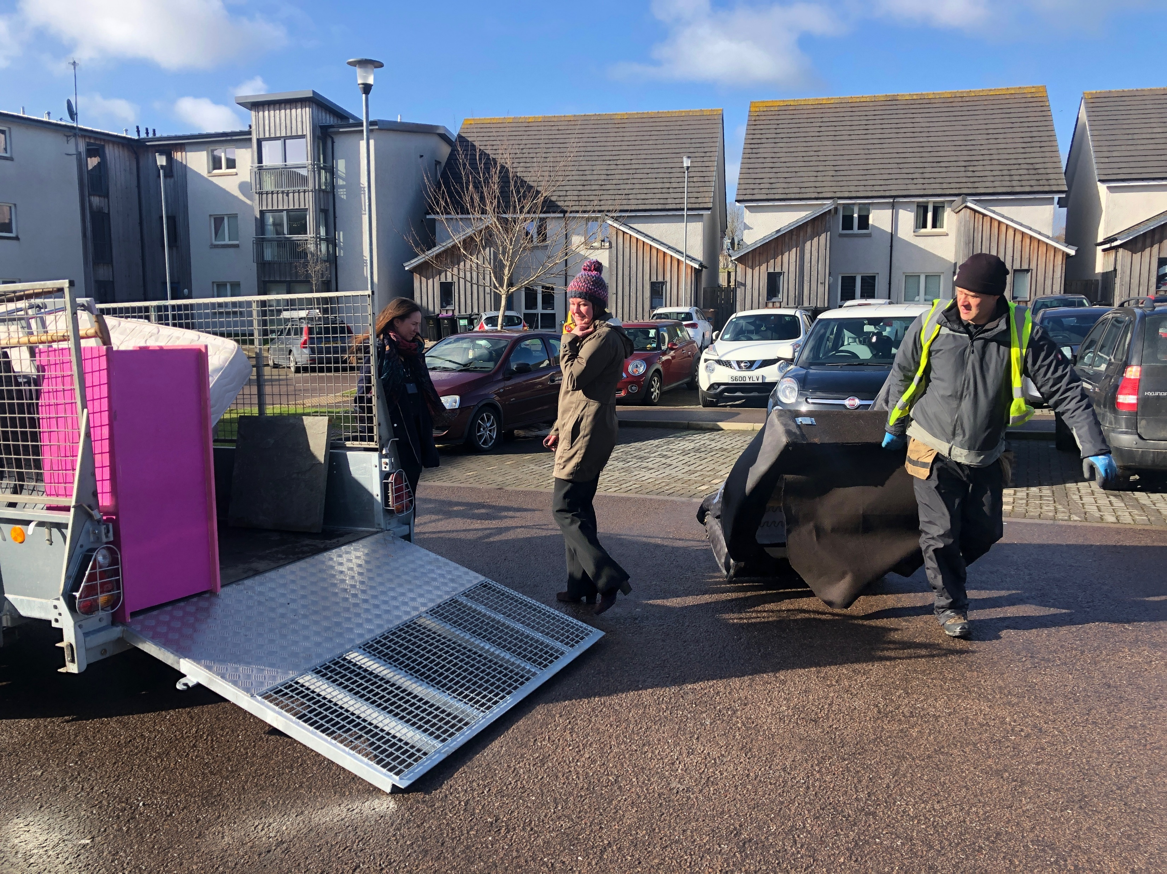
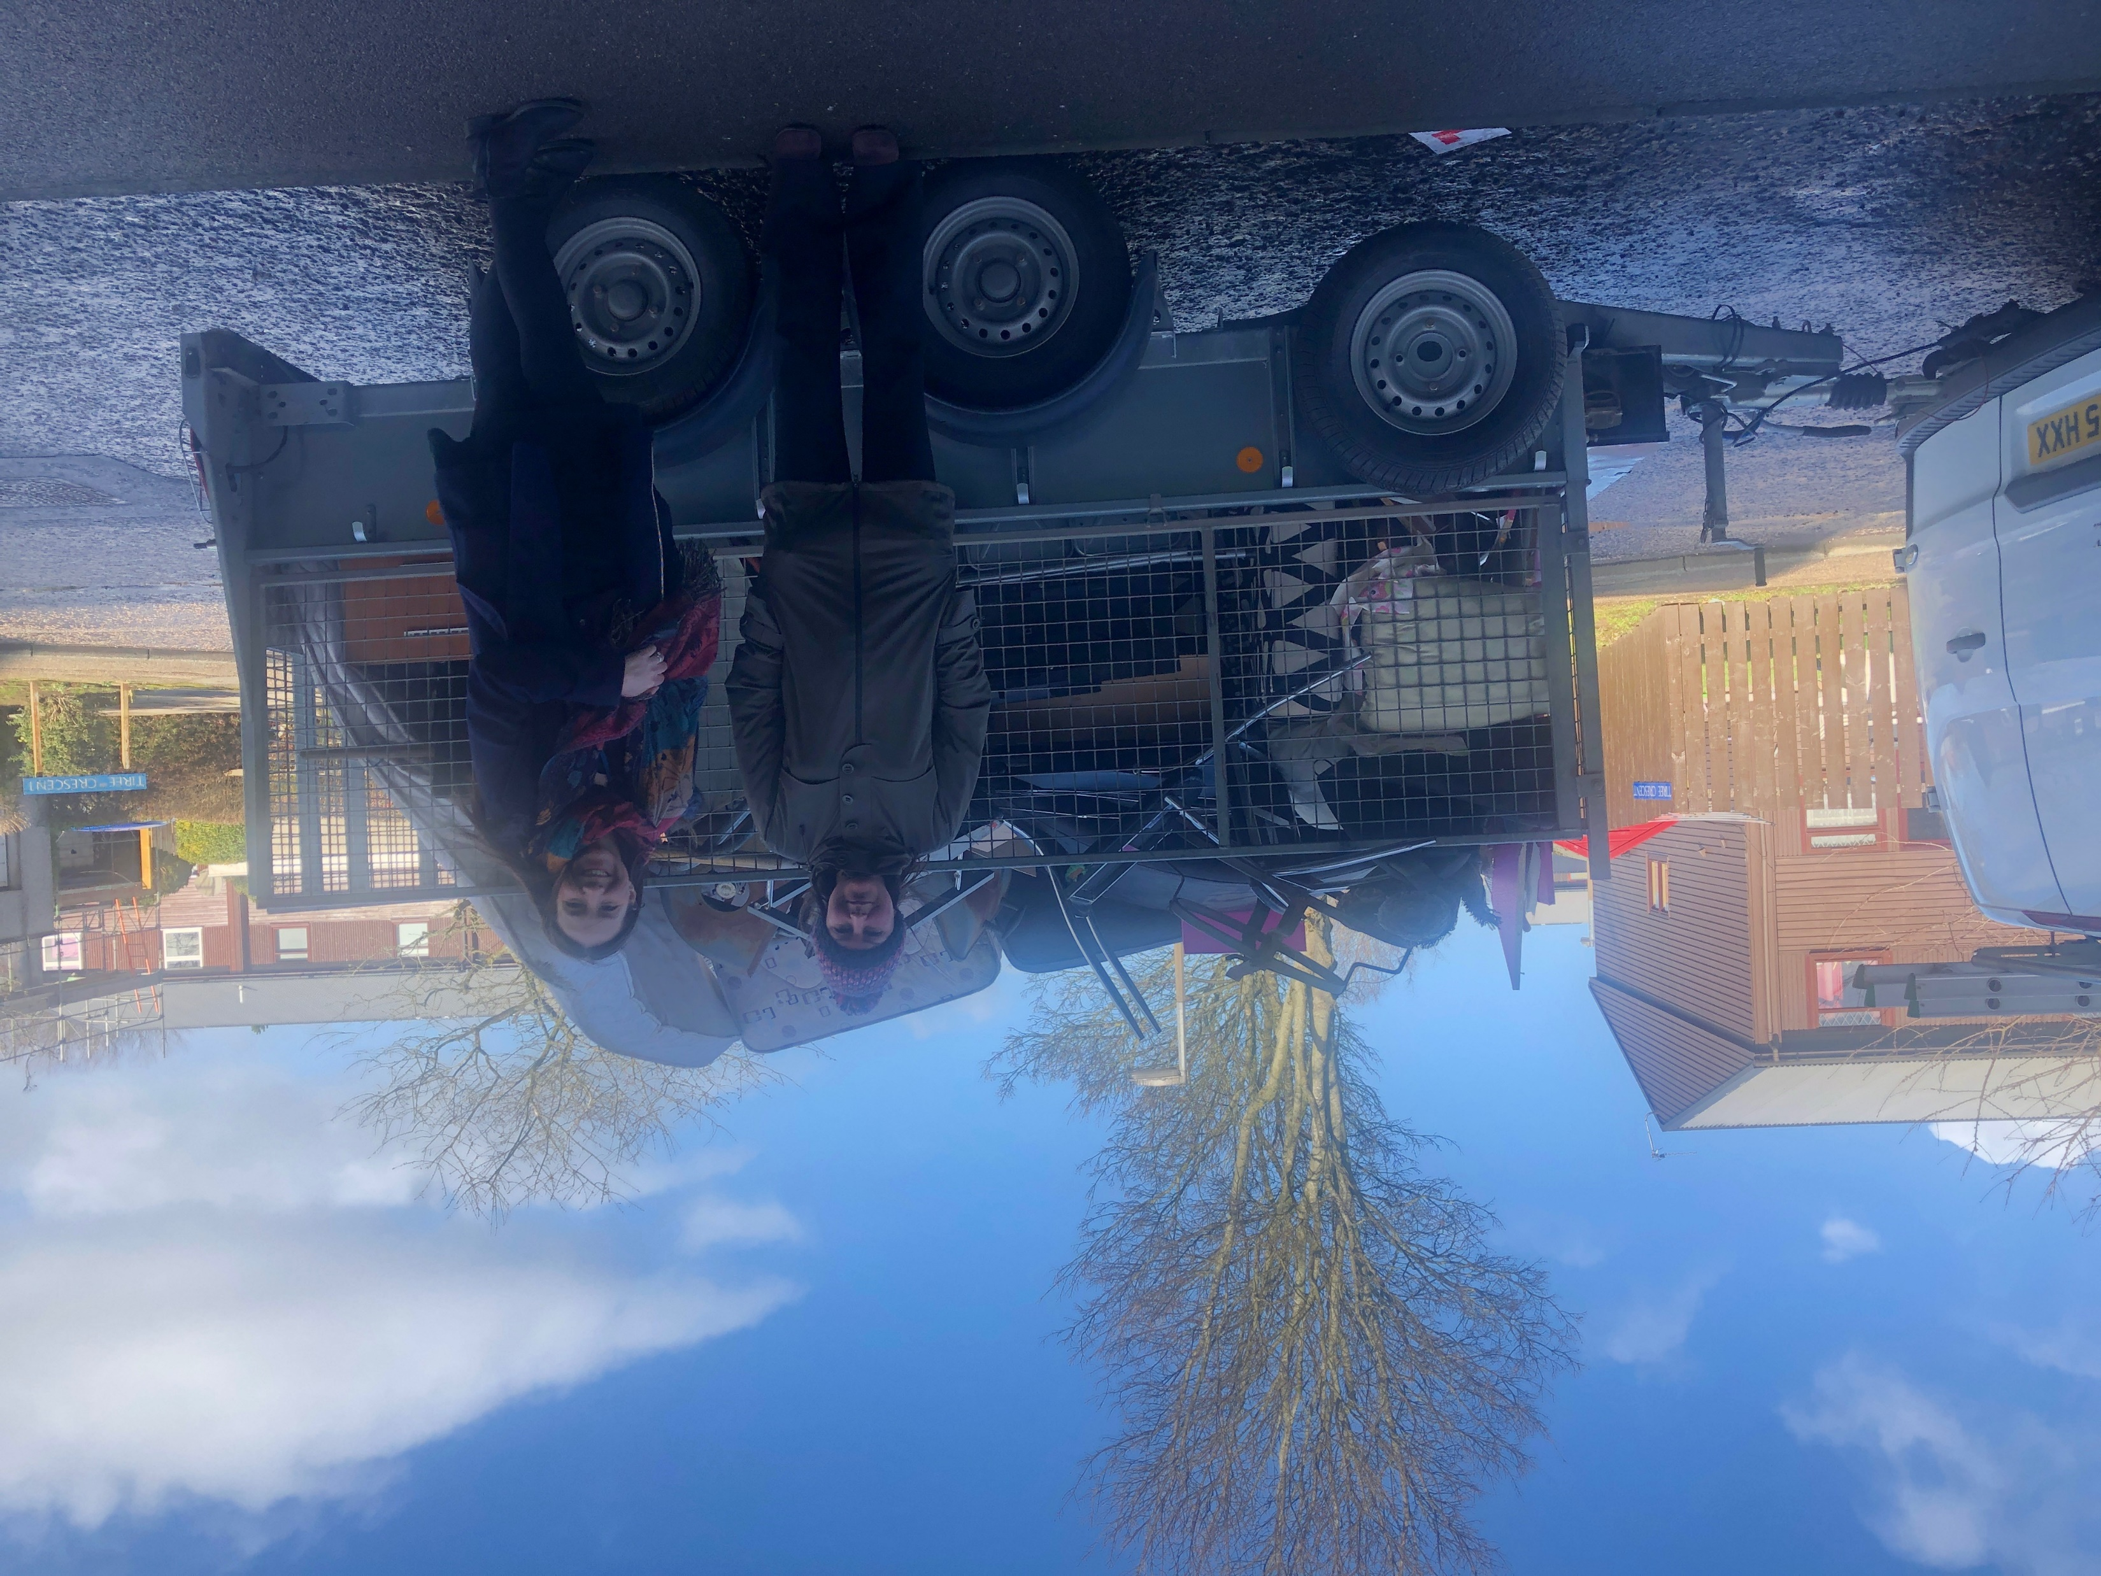
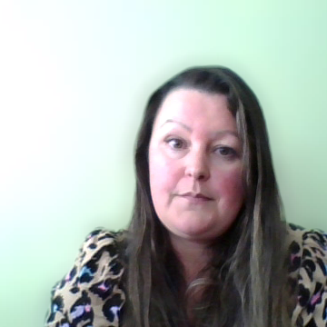
Working together
Community clean-ups
Combined roadshows
Shared policy reviews
Notes:
We work in partnership within the group a lot, the photos here are of us teaming up to do a community clean up at a shared scheme. Our members can also join each others roadshows and events, attend each other scheme inspections or team up to do community walkabouts, and we also share each others policies and strategies when we are looking at examples of good practice when we do reviews.

Slide 10
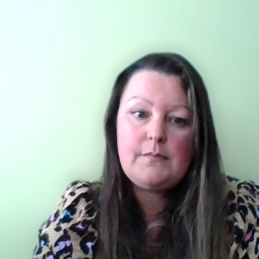
Why do our partnership groups work so well?
Learn from each other – it’s not a competition!
Support each other
Share resources and ideas
Share the workload
Strength in numbers
Notes:
We strive to be as innovative and imaginative as we can, by listening, discussing and actioning ideas that our members and wider network come up with. The beauty of the group is that everyone is equal, everyone is heard, and everyone supports each other – we are all trying to achieve the same aims, no matter which community, which area, landlord or tenant group we identify with. We are free to share ideas as there is no competition between the landlords or tenants – we know we can learn from each other and work together. There is strength in numbers, and we are so proud of and grateful our tenant volunteers who make so much effort to make the group a success and ensure that our ventures are tenant-led.

Slide 11







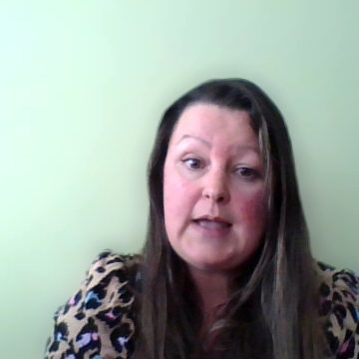



Today’s event is partnership in action!

Slide 12
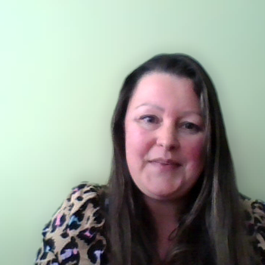
Thank you for listening
You can keep up with what NETRALT are doing at netralt.org.uk
Ask any member landlord for more information on either group
We’d love for you to join us – come along and try a group out!
Please feel free to ask any questions.

